Slide 1
Introduction to Object Oriented Analysis and Design Basics

Slide 2
Software Best Practices

Slide 3
Symptoms of Software Development
User needs not met
Requirements change
Modules don’t integrate
Code hard to maintain
Late discovery of flaws
Poor quality and performance
No coordinated effort
Build and release problems

Slide 4
Root Causes
Insufficient requirements
Communication problem
Brittle architecture
Complexity of the domain
Poor testing
Waterfall development

Slide 5
Software Best Practices
Develop Software Iteratively
Manage requirements
Visually model the software(UML)
Build component architectures
Continuously verify quality
Control changes

Slide 6
Waterfall Process
Problems
  Pushes risk forward in time
  Costly to undo mistakes from earlier phases
  Delays and aggregates integration and testing
Requirements
analysis
Design
Code and unit test
Subsystem integration
System test

Slide 7

Iterative Development Produces an Executable
Requirements
Analysis & Design
Planning
Implementation
Initial
Planning
Management
Environment
Deployment
Evaluation
Test
Each iteration results in an executable release

Slide 8
Requirement Management
A systematic approach to eliciting, organizing, documenting and managing the changing requirements of a software application
Aspects of requirement management
  Analyze the problem
  Understand the user needs
  Define the system
  Manage the scope
  Refine the system definition
  Build the right system

Slide 9
Build component architectures
Component-based architectures enable economically significant re-use
In contrast with re-use of individual modules, significant design elements
  typical frameworks for important domain or enterprise abstractions
  can be applied to multiple related applications.
The emergence of commercial component infrastructures such as Microsoft’s COM, the OMG’s CORBA, and Sun’s Enterprise Java Beans offer well-supported platforms with which to assemble component-based architectures

Slide 10
Model visually
A model is a simplification of reality that provides a complete description of a system from a particular perspective
Modeling is important because it helps the development team
  Visualize
  Specify
  Construct
  and document the structure and behavior of a system’s architecture
Use Unified Modeling Language for communication among the team members and with the client

Slide 11
Visual Modeling with UML
In building a visual model, many different diagrams are needed to represent different views of the system.UML has a rich notation for visual models. The various diagrams are
Static Diagrams
  Use-Case diagram
  Class diagram
  Object diagram
  Component diagram
  Deployment diagram
Dynamic Diagrams
  StateChart diagram
  Activity diagram
  Interaction diagrams (Colloraboration and Sequence diagram)

Slide 12
Continuously verify the quality
Software problems are 100 to 1000 times more costlier to repair after deployment
While repairing software, we might loose opportunities, eventually loosing clients
Test all the 3 dimensions of the software quality i.e. functionality, Reliability and Performance.
A software is qualitative if
  The application does functionally what’s required
  Reliable
  Software should perform under load and should be delivered on time

Slide 13
What is Analysis?
What is design?
Difference between structured and object oriented approach
Concepts related to object oriented techniques
Object oriented analysis and design
Object Oriented Analysis and Design Basics

Slide 14
Analysis
Analysis is investigation of problem and requirements, not solution
It is “What customer wants”/”What customer needs”
Analysis best qualified as
  Requirement Analysis
  Object Analysis
Requirements and Specification phases together completes a Analysis Phase
  Requirement Phase compose of preliminary study and domain study
  Specification phase explicitly describes the functionality of the product as well as the constraints attached to it
Object Oriented Analysis and Design Basics

Slide 15
Design
Design is a conceptual solution that fulfills the requirements, not implementation
In general it is “How”
Design best qualified as
  Object design
  Database design
Design is about managing complexity: a design method helps you to split big projects into manageable chunks
Architectural Design and Detailed Design completes a design phase
  Architectural Design is the high level abstraction of the system under consideration, in form of components, their interfaces and relationships.
  Detailed Design is the low level abstraction of each component in detail
Object Oriented Analysis and Design Basics

Slide 16
Analysis and Design can be summarized as; do the right thing (analysis), and do the thing right (Design)
Object Oriented Analysis and Design Basics

Slide 17
Analysis and Design Approaches
Structured Approach
  Action oriented technique
  Data oriented techniques
Object Oriented Approach
  Action oriented techniques and Data oriented techniques are two sides of a coin, captured as one in OO
Object Oriented Analysis and Design Basics

Slide 18
Differences
70 to 80s
80s Onwards
Requirement
Phase
Requirement
Phase
Data Flow Analysis Phase
OO Analysis Phase
Structure Design Phase
OO Design Phase
Structure Programming
OO Programming Phase
Integration & Maintenance
Phase
Integration & Maintenance
Phase
Object Oriented Analysis and Design Basics

Slide 19
Withdraw
Message
Message
Account
Balance
Account
Balance
withdraw
Deposit
Determine
Balance
Deposit
Determine
Balance
Message
Structured paradigm
Object Oriented paradigm
Object Oriented Analysis and Design Basics

Slide 20
Differences between structured paradigm and object oriented paradigm
Structured Paradigm
Object-Oriented Paradigm
Specification (analysis )
  Determine what the product is to do
Design phase
  Architectural design (extract the modules)
  Detailed design
Implementation phase
  Implement in appropriate programming language
Object-oriented analysis phase
  Determine what the product is to do
  Extract the objects
Object-oriented design phase
  Detailed design
Object-oriented programming phase
  Implement in appropriate object-oriented programming language
Object Oriented Analysis and Design Basics

Slide 21
Why Object Oriented Design? (Benefits)
Object-oriented systems are easier to maintain as the objects are independent. They may be understood and modified as stand-alone entities.
Changing the implementation of an object or adding services should not affect other system objects.
There is often a clear mapping between real-world entities (such as hardware components) and their controlling objects in the system. This improves the understandability and hence the maintainability of the design.
Objects are potentially reusable components because they are independent encapsulations of state and operations. Designs can be developed using objects that have been created in previous designs. This reduces design, programming and validation costs. It may also lead to the use of standard objects (hence improving design understandability) and reduces the risks involved in software development.
Object Oriented Analysis and Design Basics

Slide 22
What is object oriented Analysis and Design?
Object-oriented analysis, design and programming are all part of object-oriented development where an object-oriented strategy is used throughout the development process:
    Object Oriented Analysis
    Object Oriented Design
Object Oriented Analysis and Design Basics

Slide 23
Object-oriented analysis
Is concerned with developing an object-oriented model of the application domain. The identified objects reflect entities and operations that are associated with the problem to be solved
Object Oriented Analysis and Design Basics

Slide 24
Object-oriented design
Is concerned with developing an object-oriented model of a software system to implement the identified requirements. The objects in an object-oriented design are related to the solution of the problem that is being solved.
Object Oriented Analysis and Design Basics

Slide 25
Object Modeling Concepts

Slide 26
What is Object Oriented?
Object Oriented means that we organize software as a
collection of discrete objects that incorporate both data
structure and behavior.

Slide 27
Object oriented approach
Software solution that supports all views of system
Manage complexity of problem domain and its supporting technology easily
Handle complicated interconnections between modules
Handle large amount of information exchange

Slide 28
What is an Object?
An Object represents an entity, either physical, conceptual, or software
Objects can be concrete, such as a file in a file system, or conceptual, such as a scheduling policy in a multiprocessing system
An abstraction of something in a problem domain, reflecting the capabilities of the system to keep information about it, interact with it or both.
A paragraph in a document, a window on my workstation, and the white queen in a chess game are examples of objects

Slide 29



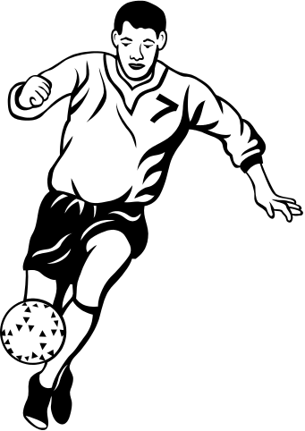


Objects
Hari’s Car
Ram’s car
A particular horse
A particular hen
maradona
This flag

Slide 30
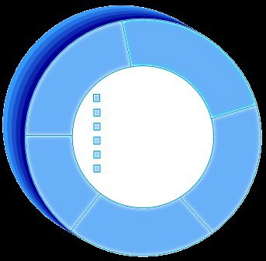
A More Formal Definition
Attributes
An object is an entity with a well-defined boundary and identity that encapsulates state and behavior.
  State is represented by attributes and relationships.
  Behavior is represented by operations, methods, and state machines.
Object
Operations

Slide 31
An Object has a state
The state of an object is one of the possible conditions in which an object may exist
The state of an object normally changes over time
Is one such state of a
Professor and if the
Status changes from
Tenured to retired,
The professor state
changes
Name: J Clark
Employee ID: 567138
Date Hired: July 25, 1991
Status: Tenured
Discipline: Finance
Maximum Course Load: 3 classes

Slide 32
An Object has a behavior
Behavior determines how an object acts and reacts
The visible behavior of an object is modeled by the set of messages it can respond to.
Professor Clark’s behavior
  Submit Final Grades
  Accept Course Offering
  Take Sabbatical
Maximum Course Load: 3 classes

Slide 33


An Object Has Identity
Each object has a unique identity, even if the state is identical to that of another object.
Professor “J Clark” teaches Biology
Professor “J Clark” teaches Biology
Every Object has a lifetime

Slide 34
What is a Class?
A class is a description of a set of objects that share the same attribute, operations, relationships, and semantics
An object provides visibility to the class
Objects are grouped into classes
A class is an abstract definition of an object.
  It defines the structure and behavior of each object in the class.
  It serves as a template for creating objects

Slide 35
Basic Principles of object orientation
Abstraction
Encapsulation
Modularity
Hierarchy

Slide 36
What Is Abstraction?
The essential characteristics of an entity that distinguish it from all other kinds of entities
Defines a boundary relative to the
perspective of the viewer
Is not a concrete manifestation, denotes the ideal essence of something
The following are examples of abstraction
  A student is a person enrolled in classes in the university.
  A professor is a person teaching classes at the university.
  A course is a class offered by the university.
  A course offering is a specific offering for a course, including days of the week and times.

Slide 37
What Is Encapsulation?
Hide implementation from clients.
  Clients depend on interface.

Slide 38
Encapsulation Illustrated
Professor Clark needs to be able to teach four classes in the next semester.
SubmitFinalGrades()
AcceptCourseOffering()
Name: J Clark
Employee ID: 567138
HireDate: 07/25/1991
Status: Tenured
Discipline: Finance
MaxLoad:4
SetMaxLoad(4)
SetMaxLoad()
TakeSabbatical()
Professor Clark

Slide 39
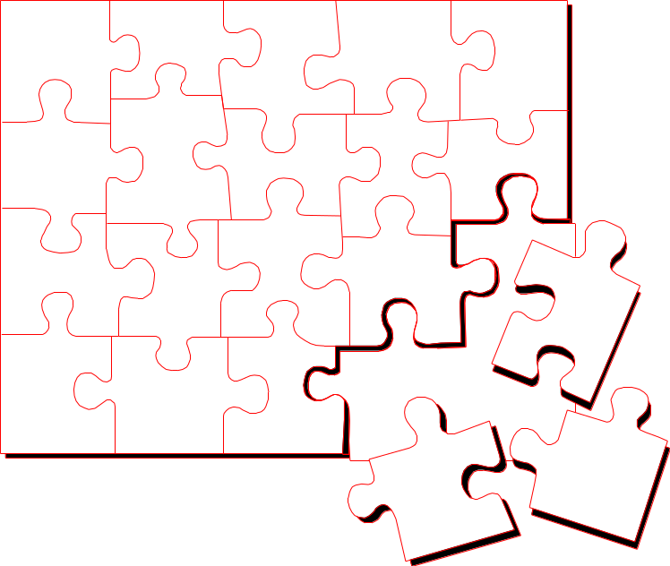
What Is Modularity?
Modularity is the breaking up of something complex into manageable pieces.
Modularity helps people to understand complex systems.

Slide 40
What Is Hierarchy?
Asset
Increasing
abstraction
BankAccount
Security
RealEstate
Savings
Checking
Stock
Bond
Decreasing
abstraction
Elements at the same level of the hierarchy should be at the same level of abstraction.

Slide 41
What Is Polymorphism?
The ability to hide many different implementations behind a single interface
Manufacturer B
Manufacturer A
Manufacturer C
OO Principle:
Encapsulation

Slide 42
Example: Polymorphism
Get Current Value
getCurrentValue()
getCurrentValue()
getCurrentValue()
Stock
Bond
Mutual Fund

Slide 43
OO Modeling

Slide 44
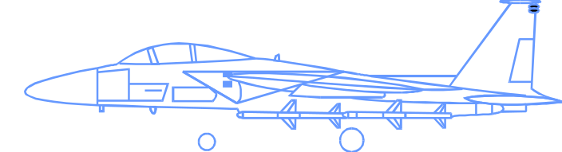
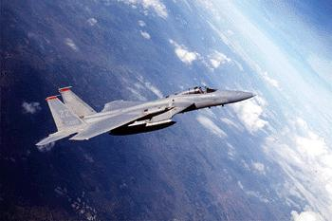
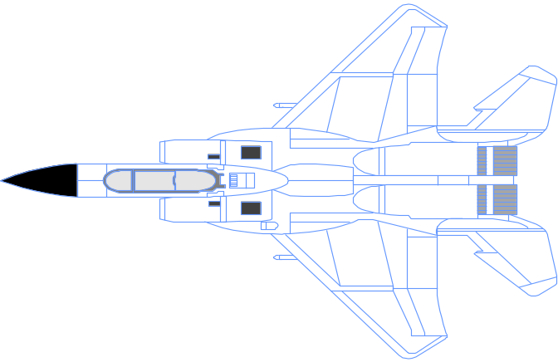

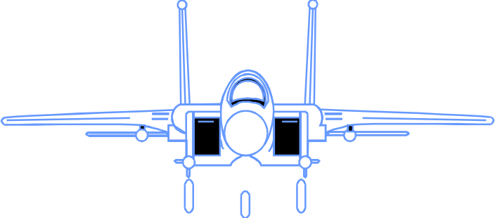
What Is a Model?
A model is a simplification of reality.

Slide 45
Why do we Model?
Better understand the systems we are developing
  Helps us to visualize a system as we want it to be.
  Permits us to specify the structure or behavior of a system.
  Gives us a template that guides us in constructing a system.
  Documents the decisions we have made.

Slide 46
Relationships in the UML
The 4 kinds of relationships in the UML are –
Association
Dependency
Realization
Generalization
Notes:
Dependency –
A dependency is a semantic relationship between two things in which a change to one thing(the independent thing) may effect the semantics of the other thing(the dependent thing).Graphically , a dependency is rendered as a dashed line, possibly directed, and occasionally including a label.
Association –
An assciation is a structural relationship that describes a set of links, a link being a connection among objects. Aggregation is a special kind of association, representing a structural relationship between a whole and its parts.Graphically, is is rendered as a solid line , possibly directed, occasionally including a label, and often containing other adornments, such as multiplicity and role names.
Generalization –
A generalization is a specialization/generalization relationship in which objects of the specialized element (the child) are substitutable for objects of the generalized element (the parent). In this way, the child shares the structure and the behaviour of the parent. Graphically, a generalization relationship is rendered as a solid line with a hollow arrowhead pointing to the parent.
Realization –
A realization is a semantic relationship between classifiers,wherein one classifier specifies a contract that another classifier guarantees to carry out. Realization relationships is encountered in 2 places.
Between interfaces and the classes or components that realize them.
Between use cases and the collaborations that realize them.
Graphically, a realization relationship is rendered as a cross between generalization and a dependency relationship.

Slide 47
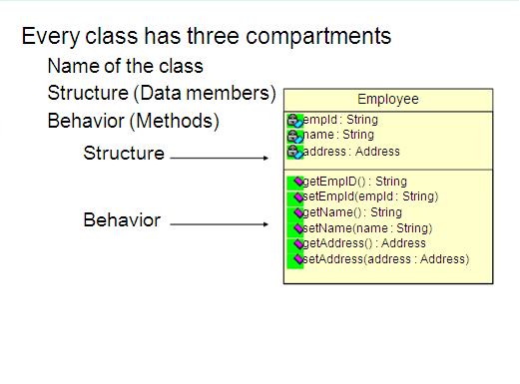
Class Diagram
Notes:
In this session, you will create your own data types, overload different operators and enhance the classes already created by you.

Slide 48
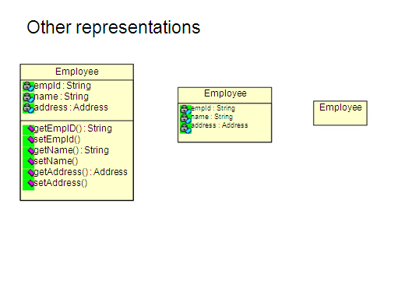
Notes:
In this session, you will create your own data types, overload different operators and enhance the classes already created by you.

Slide 49
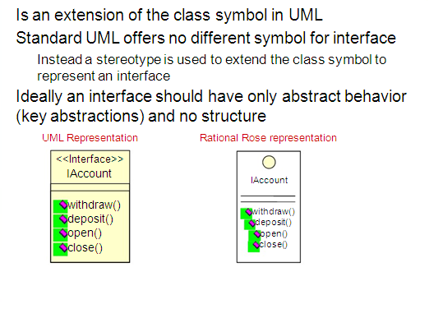
Interface
Notes:
In this session, you will create your own data types, overload different operators and enhance the classes already created by you.

Slide 50
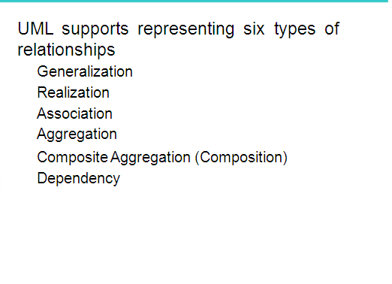
Relationships
Notes:
In this session, you will create your own data types, overload different operators and enhance the classes already created by you.

Slide 51
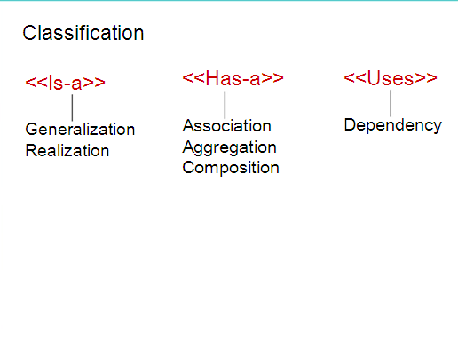
Relationships
Notes:
In this session, you will create your own data types, overload different operators and enhance the classes already created by you.

Slide 52
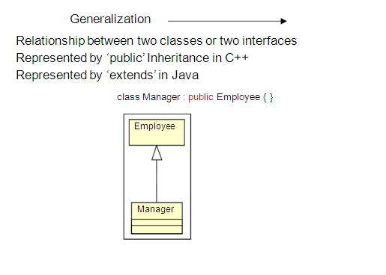
Generalization
Notes:
In this session, you will create your own data types, overload different operators and enhance the classes already created by you.

Slide 53
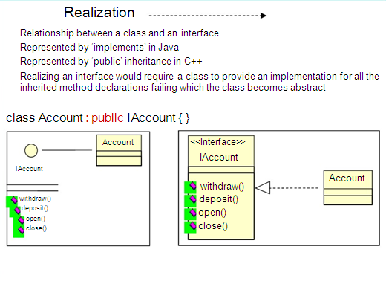
Realization
Notes:
In this session, you will create your own data types, overload different operators and enhance the classes already created by you.

Slide 54
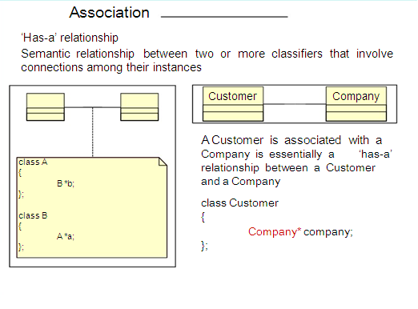
Association
Notes:
In this session, you will create your own data types, overload different operators and enhance the classes already created by you.

Slide 55
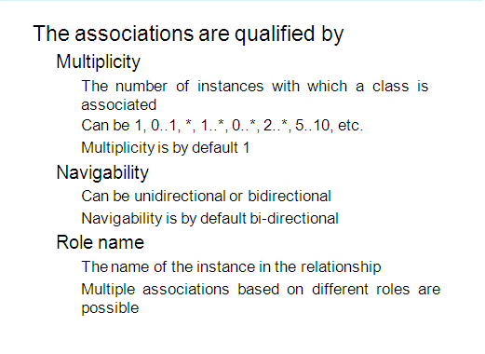
Association
Notes:
In this session, you will create your own data types, overload different operators and enhance the classes already created by you.

Slide 56
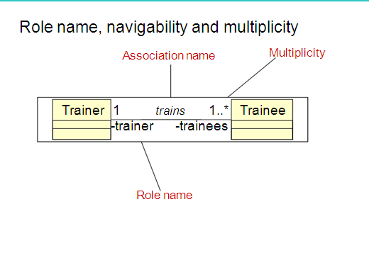
Association
Notes:
In this session, you will create your own data types, overload different operators and enhance the classes already created by you.

Slide 57
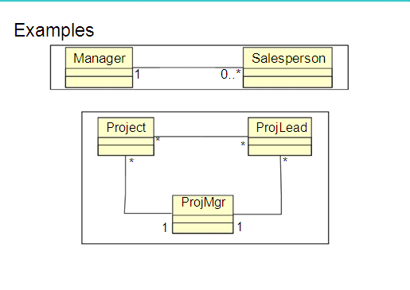
Association
Notes:
In this session, you will create your own data types, overload different operators and enhance the classes already created by you.

Slide 58
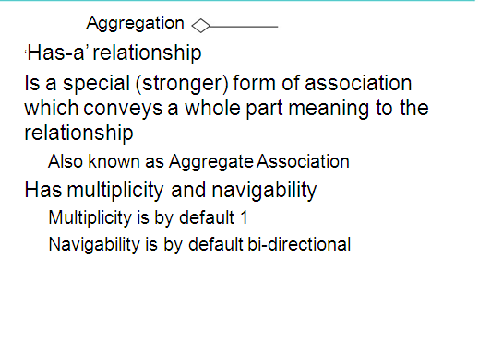
Aggregation
Notes:
In this session, you will create your own data types, overload different operators and enhance the classes already created by you.

Slide 59
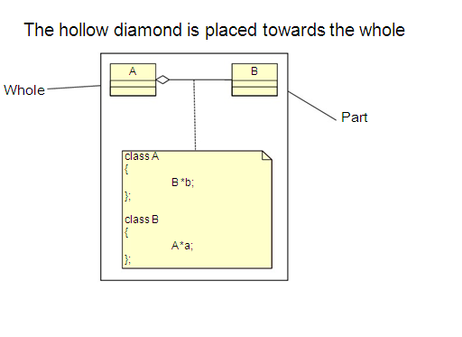
Aggregation
Notes:
In this session, you will create your own data types, overload different operators and enhance the classes already created by you.

Slide 60
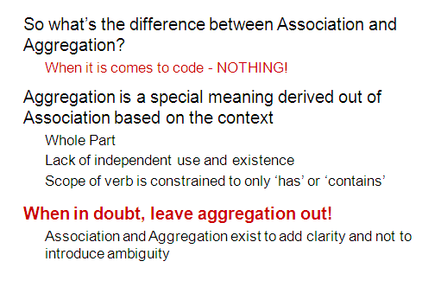
Aggregation
Notes:
In this session, you will create your own data types, overload different operators and enhance the classes already created by you.

Slide 61
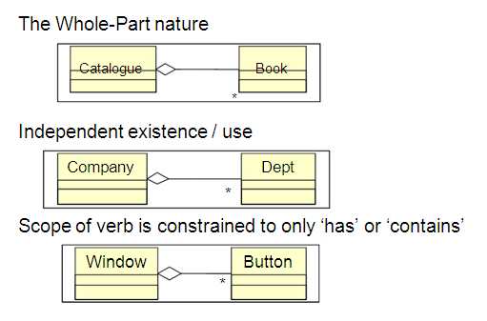
Aggregation
Notes:
In this session, you will create your own data types, overload different operators and enhance the classes already created by you.

Slide 62
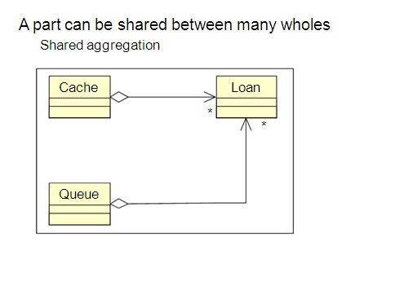
Aggregation
Notes:
In this session, you will create your own data types, overload different operators and enhance the classes already created by you.

Slide 63
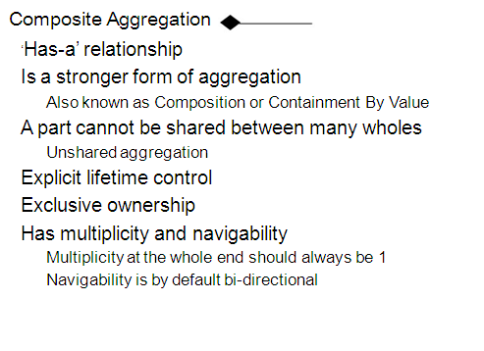
Composite Aggregation
Notes:
In this session, you will create your own data types, overload different operators and enhance the classes already created by you.

Slide 64
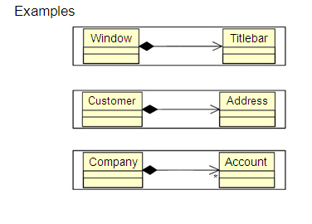
Composite Aggregation
Notes:
In this session, you will create your own data types, overload different operators and enhance the classes already created by you.

Slide 65
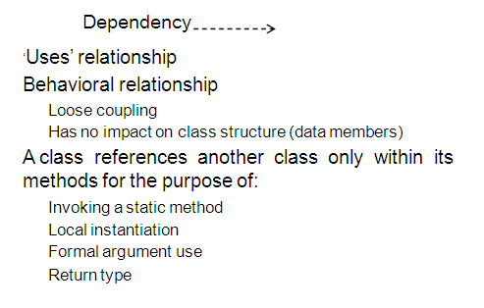
Dependency

Slide 66
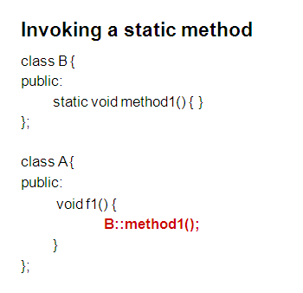
Dependency

Slide 67
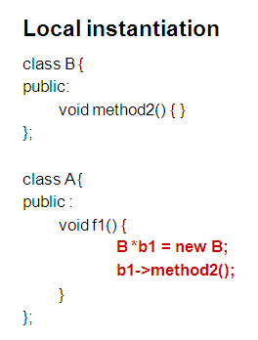
Dependency

Slide 68
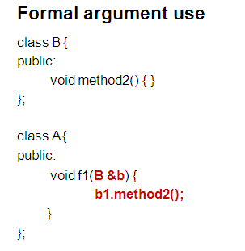
Dependency

Slide 69
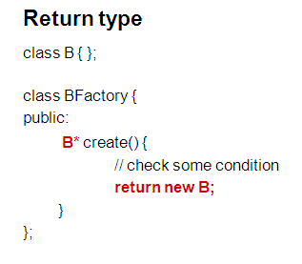
Dependency

Slide 70
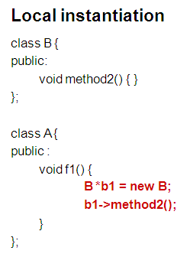
Dependency

Slide 71
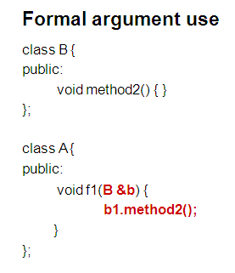
Dependency

Slide 72
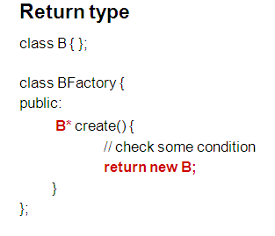
Dependency

Slide 73
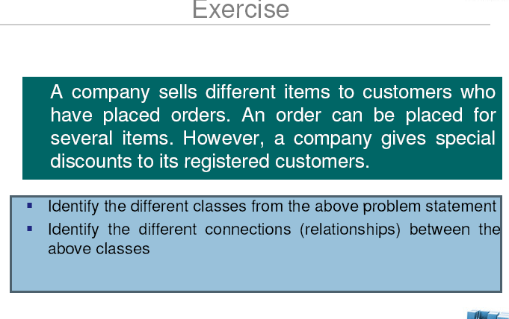

Slide 74
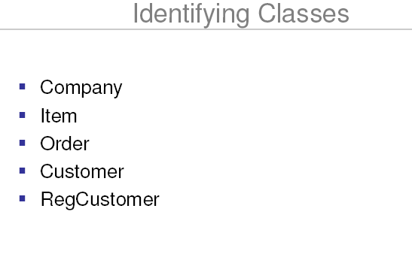

Slide 75
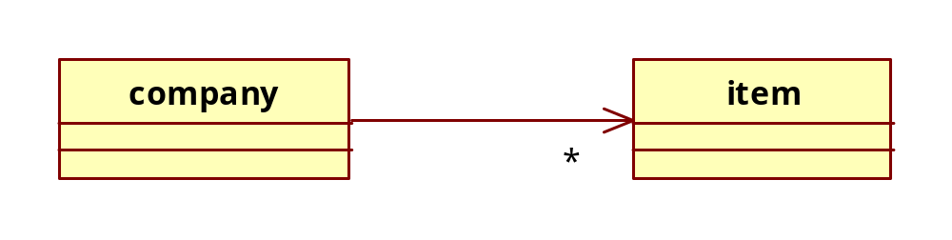
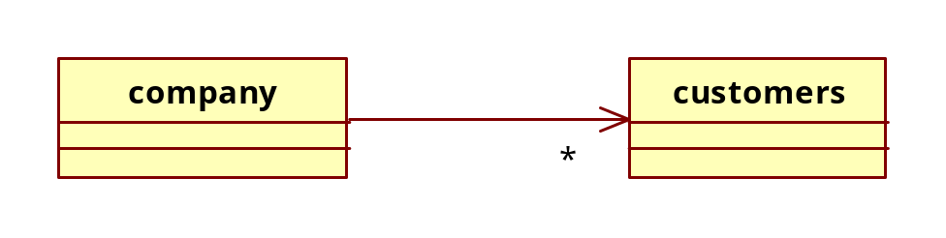
Identifying Relationships
Company has many Items
Company has many Customers
Unification

Slide 76
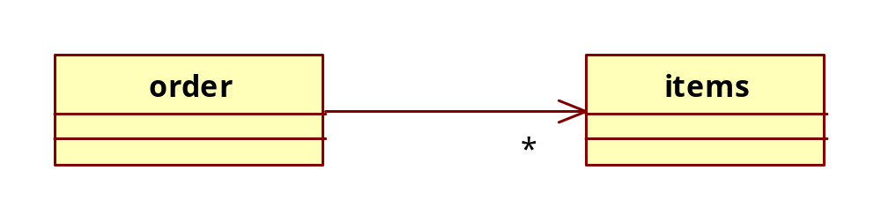
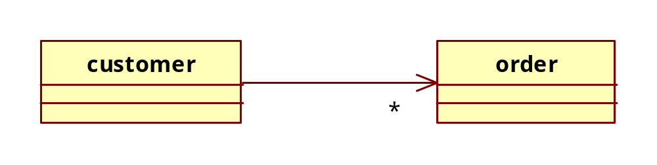
Identifying Relationships
Order has many Items
Customer has orders
Unification

Slide 77
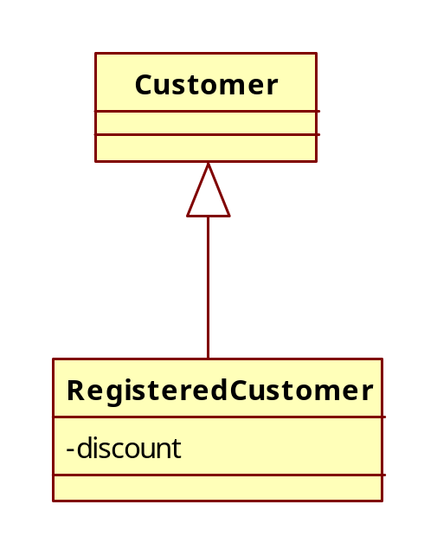
Identifying Relationships
Register Customer is a Customer
Unification

Slide 78
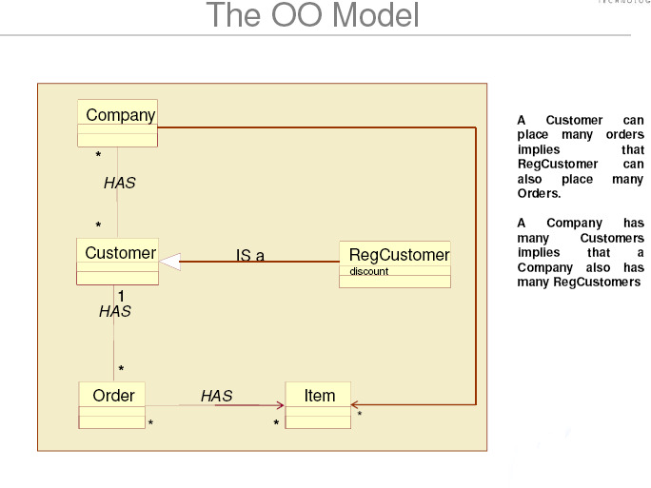

Slide 79
Introduction to Rational Unified Process

Slide 80
Introduction
Rational Unified Process best implements the best practices of the software engineering
RUP is
  Iterative and incremental
  Use case driven
  And architecture centric process

Slide 81
History of Unified Process
Rational Unified Process (1995)
Several Other Sources
Rational Objectory Process (1987-1995)
The Rational Approach
UML
Objectory Process (1976-1987)
The Ericsson Approach

Slide 82
The Ericsson Approach
System is divided into blocks
The blocks realize the use cases
The blocks are combined to form subsystems
The approach resulted in static block diagrams
Software Architecture description document was designed to understand the critical requirements.
The blocks interacted via messages that formed the message library.
Later for each use case, dynamic diagrams i.e. sequence diagram and collaboration diagrams was designed.
Ivar Jacobson enhanced the approach of blocks into component based development that are executable and deployable.
In 1976,the specification and description language for functional behaviour of telecommunications systems was designed.

Slide 83
Objectory Approach
Ivar Jacobson left Ericsson and established Objectory AB in 1987
Next 8 yrs he and associated developed a process called Objectory and extended it telecommunication industries.
The concept of use cases used in Ericsson work was now given a name and diagram represenattion.
Successive workflows and models were designed – requirements model,use case model, analysis model , design model, implementation model and test model.

Slide 84
Rational Approach
Rational Software Corporation acquired Objectory AB in 1995
Rational aimed at unifying the basic principles underlying the existing software development processes.
The process was defined as architecture centric, use case driven and iterative & incremental.
Four phases approach was devised – inception phase, elaboration phase, construction phase and transition phase
Four views for architecture was devised - logical view, process view, physical view and development view.

Slide 85
Rational Objectory Process(1995 – 1997)
Rational experience and practices were added to form rational Objectory Process 4.1
The phases , workflows and views of the 2 approaches were combined.
Architecture was made explicit in the form of architecture description document
In 1990’s, the need was a uniform and consistent visual language to express the results of object oriented methodologies became evident
Grady booch developed the Booch method and Ivar jacobson developed OMT(Object modeling technique)
James Rambaugh joined rational in 1994 and Ivar Jacobson joint in 1995
The three together released UML 0.9

Slide 86
Rational Unified Process
During this period, Rational acquired or merged with other software tool companies.
By mid 1998, the Rational Objectory process had become full fledged process to support all entire software development life cycle
With the process being accepted universally by all industries include telecommunications, it was renamed as Rational Unified Process

Slide 87
Unified Process in a Nutshell
It is a software development process
It defines a set of activities needed to transform a user’s requirements into a software system
It is component based – the software is made up of components interconnected via well defined interfaces
The 3 distinguishing aspects are
  Use case driven
  Architecture centric
  Iterative and incremental

Slide 88
Use Case Driven
Use case driven means that the develoment is based on a series of work flows that derived from use cases
A use case is a piece of functionality in the system that gives a user a result of value – for eg, withdrawal is a use case wrt a customer making a request at the ATM.
Use cases capture the functional requirements
All use cases together make up the use case model describing the functionality of the entire system
Based on use case model , developers create design and implementation models to realize the use cases
The testers test the implentation
Developers and testers check if their design and test is in sync with the use case model or not
Use cases and architecture mature in parallel

Slide 89
Architecture Centric
Architecture is the view of the whole design with the important characteristics made more visible by leaving details aside.
Software architect role is similar to the role of an architect in building construction who looks into the various views of the building / system
Software architecture consists of static and dynamic aspects of the system.
It is influenced by factors like – platform, computer architecture, operating system, database management system ,protocols for network communications, framework, deployment considerations and non-functional requirements.
The architect
  Creates a rough outline of the architecture using use cases which are independent
  Next, the specific use cases are taken into consideration
  Use cases are realized
  As the use cases are specified and matured, more of the architecture is discovered.

Slide 90
Iterative and Incremental
Iterations refer to the steps in the workflow
It is practical to divide the system into smaller pieces or mini-projects. Each mini-project is an iteration.
Each iteration deals with a group of use cases that together extend the usability of the product. In each iteration the most important risks are considered and resolved.
In every iteration, developers identify and specify the relevant use cases, analyze create the design, implement the design in components and verify if the components satisfy the use case.
Benefits of iterative process
  Reduces the cost risk by eraly detection and rectification of defects
  Reduces the risk of not deploying the product on time
  Speeds up the development process as all the team members are clear and short focussed with the vision and goal of the product.
  It acknowledges the reality

Slide 91
Life Cycle of a Unified Process
Unified process repeats over a a series of cycles and each cycle concludes with a product release to customers
Each cycle consists of 4 phases
  Inception phase
  Elaboration phase
  Construction phase
  Transition phase
Each phase is further subdivided into iterations

Slide 92
Life cycle of Unified Process contd
Each cycle results in a new release of the system.The finished product includes requirements,use cases, non-functional specifications, test cases and visual models
Models required to represent the software product are
  Use case model – comprises of all use cases and their relationships
  Analysis model – refines the use cases in more detail and makes an initial allocation of the system behaviour
  Design model – defines the static structure of the system as subsystems, classes and interfaces. Uses cases are realized.
  Implementation model – Includes components and the mapping of classes to components
  Deployment model – defines the physical nodes of computers and the mapping of components to the nodes
  Test model – describes the test cases that verify the use cases

Slide 93
Phases within a cycle
Each cycle consists of 4 phases and each phase terminates with a milestone by the availability of certain artifacts and documents.
In each phase the product development realizes the following workflows
  Requirements
  Analysis
  Design
  Implementation
  Test

Slide 94
Process Structure - Lifecycle Phases
Inception
Elaboration
Construction
Transition
time
The Rational Unified Process has four phases:
  Inception - Define the scope, vision and the business model of
  the project.
  Elaboration - Plan project, specify features, baseline architecture
  Construction - Build the product
  Transition - Transition the product into end user community
Certain milestones needs to be achieved at the end of each phase

Slide 95
Inception Phase
During this phase
A use case model with the most critical use cases is developed
The architecture is tentative – contains just the outline of the crucial subsystems
Important risks are identified and prioritized
Whole project is roughly estimated
Milestones
  What is the system primarily going to do for each of the major users
  What could the architecture for that system look like
  What is the plan
  What is the cost involved to develop the product

Slide 96
Elaboration Phase
During this phase,
  Use cases are realized in detail
  Architecture is expressed as views of all the models
  The architecture baseline is designed
  Project managers are in a position to plan the activities, estimate the cost and resources
Milestones
  Are the use cases , architecture and plan stable enough
  Are the risks under sufficient control

Slide 97
Construction Phase
During this phase,
  Product is built
  Architecture baseline grows to become a full-fledged system
  At the end the product contains all the use cases that the management and customers agreed upon to develop
  Product may not be entirely free from defects
Milestone
  Does the product meet the user’s needs sufficiently

Slide 98
Test Phase
During this phase,
  The product moves into beta release.
  In beta release a few users try the product and report defects and deficiencies if any
  Developers then correct the defects, incorporate some of the suggested improvements
  Activities such as training customer personnel, providing help assistance and correcting errors found after delivery is organized
Milestone
  Is the system bug-free to deploy to the customers location

Slide 99
Iterations and Phases
Inception
Elaboration
Construction
Transition
Preliminary
Iteration
Architect.
Iteration
Architect.
Iteration
Devel.
Iteration
Devel.
Iteration
Devel.
Iteration
Transition
Iteration
Transition
Iteration
Minor Milestones: Releases
An iteration is a distinct sequence of activities based on an established plan and evaluation criteria, resulting in an executable release (internal or external).

Slide 100

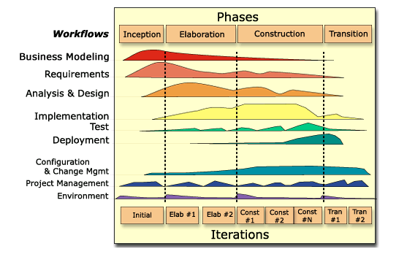

Bringing It All Together: The Iterative Approach
In an iteration, you walk through all workflows
Workflows group activities logically

Slide 101
Use case Modeling

Slide 102
Need for Use Case Modeling
The use case model is the set of all the use cases,actors and use-case-actor associations used to describe a particular system.
A use case model is often represented by a set of use-case diagrams
During the analysis and design, the use case model is transformed
into a design model via the analysis model.
It helps us
To get to understand what the system must do.
Use Case Model establishes the system's functional requirements
Use case model is used to reach an agreement with the users and customers as to what the system should do and does it meet the customers requirements.
Page <number>

Slide 103
Building Blocks of a Use Case Model
The building blocks are
Actors – represented by a stick
Use Cases – represented by an ellipse
Page <number>
Notes:
Actors
An actor defines a role that a user can play when interacting with the system. A user can either be an individual or another system.
Actors according to the UML – A coherent set of roles that users of use cases play when interacting with the use cases
Actors represent the people or things that interact in some way with the system.By definition,they are outside the system.We focus on the actors to ensure that the system does something useful.Actors have a name and a short description and they are associated with the use cases with which they interact.
User is represented as an actor.
Actors use the system as they interact with the use cases.
All the actors and use cases of a system together represent the use case model
Use Cases
A use case describes how an actor uses a system to achieve a goal and what the system does for the actor to achieve that goal.It tells how the actors and the system collaborate to deliver something of value.
Use Cases represent the things of value that the system performs for its actors.Use cases are not functions or features, but a scenario.Use cases have a name and brief description.They also have a detailed descriptions about how the actors use the system to do something they consider important and what the system does to satisfy these needs. A use case is a description of set of actions that a system performs that yields an observable result of value to a particular actor.
Use cases provide major input when
Finding and specifying classes, subsystems and interfaces
Finding and specifying test cases
Planning development iterations and system integration - Each iteration is driven through the whole set of workflows from requirements capture,via analysis,design and implementation, to test and bind together these different workflows.

Slide 104
Capturing the use cases
Steps
Identify the customer /user requirements
Functional requirements are expressed as use cases in a use-case model
Non functional requirements like performance, accuracy, security etc are either attached to the use cases concerned or kept in a separate list
Actors and use cases result in a use-case model
Page <number>
Notes:
Functional requirements – are those actions that a system must be able to perform,without taking the physical constraints into consideration.The functional requirements specify the input and output behavior of a system.For eg, in a telephone system – the system shall terminate the call when either the caller or the callee hangs up.
Non Functional requirements – specify the other qualities that the system must have , such as those related to the usability,reliability,performance and supportability of the system.For eg, in the telephone system – the response time between the completion of dialing and the ringing of the requested device shall be less than 0.5 seconds in 95 percent of all cases.

Slide 105
Advantage of Use Cases
Help in capturing the functional requirements.
Help us carry out iterative development
Use cases are intuitive
Help developers to identify and build the classifiers
Help the project managers to plan
Page <number>
Notes:
Use cases offer a systematic means of capturing functional requirements
Use cases help us carry out iterative development - They drive through all the workflows, from requirements to design and testing, resulting in an increment. Each development increment is thus a working realization of a set of use cases. Design and test can also be planned and coordinated in terms of use cases
Use cases are intuitive - Users and customers do not have to learn complex notation. Just plain English is sufficient which makes it easier to read use case descriptions and to propose changes.
Use cases help the Developers to identify and build the classifiers i.e classes interfaces , components etc
They help us develop user interfaces that makes it easier for the users to perform the tasks
Use cases help the project managers to plan, assign and monitor many of the tasks that developers carry out.

Slide 106
Advantages of Use Cases
6) Use cases support traceability
7) Use cases provide a Conceptual Model of the System
8) Use Cases describe how the system is used and what the system does for its stakeholders
Page <number>
Notes:
Use cases support traceability
A use case in the requirements is traceable to its realization in analysis and design, to all the classes participating in realizing it, to components and finally to the test cases that verify it.
When a use case is changed, the corresponding classes, components and test cases should also be updated.
The traceability between the use cases and the other model elements makes it easier to maintain the integrity of the system and to keep the system as a whole up-to-date with changing requirements.
Use cases provide a Conceptual Model of the System
To use a system, we must have a mental model of how it woks.This mental model helps us to form strategies of how we can use the system to accomplish tasks.Use cases help us to explore,form and refine the mental model of how the system will work.If the system is to be usable, it is essential that it have a simple mental model that is consisstently applied throughout the design.The users and the builders of the system must share this mental model for the system to be useful.Use cases and use-case model help all the stakeholders to have a common shared vision about the system’s capabilities and responsibilities.
Use Cases describe how the system is used and what the system does for its stakeholders
Use cases are very good at describing the interactions between the users of a system and the system itself.They capture what a user does to initiate some behavior in the system and in turn what the system does to provide the required behavior.They clearly define the responsibilities of the system with regard to satisfying the goals of the users,and the responsibilities of the users with regard to supporting the system.
In fact,use cases capture a large,usually the largest , subset of the software requirements for the system.The use-case model itself is a vehicle for organizing the software requirements in an easy-to-manage way.It allows stateholders,customers,users and developers to understand the requirements and enables them to communicate about their needs in a consistent,non-redundant way.It also allows the developers to divide the requirements-capture work among themselves and then use the results as input when analyzing,designing,implementing and testing the system.
Use cases are very powerful because they place requirements in context by showing how the system provides value for its stakeholders while making the requirements easier to understand.
Use cases focus on the functionality of the system and require additional,more declarative requirements statements to provide a full-software requirement specification.
The use-case model should have be supported by additional requirements documentation that contains functional and nonfunctional requirements or systemwide requirements that do not readily fit into the use-case model.These are captured in the supplementary specifications documentation and are often referred to as Supplementary Specifications which is one of the standard Rational Unified Process requirements artifacts.

Slide 107
Properties of Use Cases
Name
Brief Description
Flow of Events
Special requirements
Preconditions
Postconditions
Extension points
Relationships
Diagrams
Page <number>

Slide 108
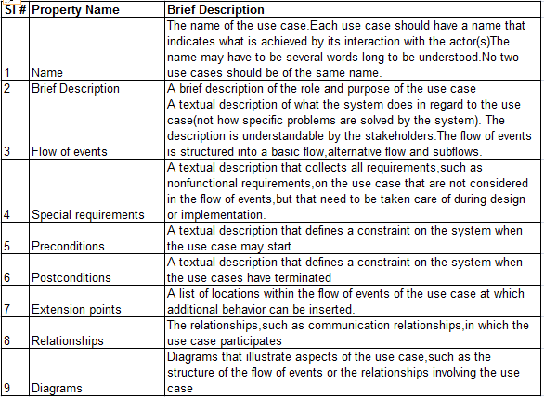
Unification

Slide 109
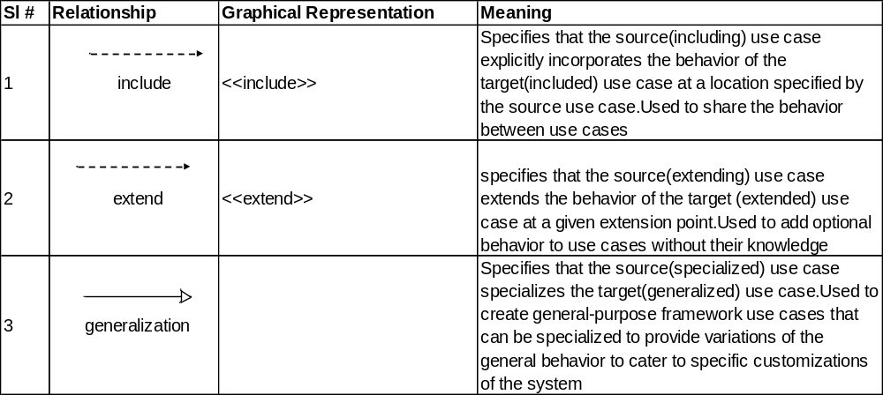
Use Case Relationships
Page <number>

Slide 110
Use Case Relationship contd
include relationship
Answer Customer Inquiries
Caller
Customer Service Represenattive
<<include>>
Maintain Customer Information
Page <number>

Slide 111
Use Case Relationship contd
extend relationship
Process Transactions
Caller
<<extend>>
Generate the Transaction Statement
Customer
Page <number>

Slide 112
Use Case Relationship contd
Generalization Relationship
Customer
Transaction
Banking System
Deposit
Withdraw
Page <number>

Slide 113
Use Case diagram
A use case diagram describes a part of the use-case model and shows a set of use cases and actors with an association between each interacting pair of actor and use case.
Actors – represented as stick
Use Cases – represented as ellipses
Use-Case-Actor association – represented as a line/arrow
Page <number>

Slide 114
Use case diagram -example
A Simple telephone system
Place local call
Caller
Callee
Place long-distance Call
Retrieve Customer Billing Information
Billing system
Get Call History
Page <number>
Customer
System Boundary

Slide 115
Use Case Diagram rules
Each actor and use case must have a brief description, no more than a few sentences long,that state what it is and why it exists.
Describe the following
1) Caller
A Caller is any person or external device that uses the system to make a phone call
2) Customer
A Customer is the person,or authorized representative of the organization,that pays the bills.The Customer is the owner of the account with the telecom’s provider.The customer is identified by an account number
3) Get Call History
The use case GetCall History provides the Customer with the ability to access the details of all the calls that have been charged to the account.This the call history is made available in both text and audio formats
Page <number>

Slide 116
Use-Case Description
Use Case descriptions provide the substance of the use-case model , and they are the basis for most of the use-case modeling work.
The use-case description gives details of the following use-case
properties
Flow of events
  Basic Flow
  Alternative Flows
  Subflow
Preconditions
Postconditions
Page <number>
Notes:
Basic Flow
Basic flow is the description of the normal,expected path through the use case This is the path taken by most of the users most of the time.
Alternative Flows
The flow is considered detours.Some of these occur at the actor’s discretion or the system’s discretion.
Subflow
As a use case becomes more detailed,the text of the individual flow of events can become unwieldy and overlong. In such situations, a series of smaller,self-contained subsections, each with its own clearly identifiable purpose can be described and these series form the subflows.

Slide 117
Use-Case Description-Basic Flow
Describe the Basic Flow for the use case Place Local Call
The use case starts when the Caller lifts the receiver
The Caller enters the number to be called
The system connects the Caller’s phone to the requested device
The call is made
The connection is terminated
The details of the call are recorded
The use case ends
Page <number>

Slide 118
Use-Case Description-Alternate Flow
Describe the Alternate Flow for the use case Place Local Call
1) No Answer
If the Callee does not respond,the Caller terminate the call and the use case ends
2) Line Busy
If the Callee’s line is in use,the system rings the busy tone. The Caller then terminates the call and the use case ends
3) Number Dialed Not Known
The system cannot identify a receiving device from the number dialed
4) Number is Engaged
The receiving device is already involved in a call
5) The Signal is lost
The carrier/signal is lost during the call
Page <number>

Slide 119
Use-Case Description-SubFlow
Describe the SubFlow called Connect Caller and Callee for the Basic Flow stated below
The system connects the Caller’s phone to the requested device
The system analyzes the digits of the entered number and determines the network address of Callee
The system determines whether a connection can be established between the Caller and Callee
The system establishes the connection
The system rings Callee’s phone
The Basic Flow is now described as
The use case starts when the Caller lifts the receiver
The Caller enters the number to be called
Perform Connect Caller and Callee
The call is made
The connection is terminated
The details of the call are recorded
The use case ends
Page <number>

Slide 120
Use Case Description – Pre and Post Conditions
Describe the following for the use case Place Local Call
Pre-condition
The Caller’s device has a connection to the system,i.e. the carrier signal is there
Post-condition
The connection between the Caller and Callee has been terminated and all call details have been recorded.
Page <number>

Slide 121
Use Case Description – Supplementary Specification
The supplementary requirements capture the system requirements
and Application development standards that are not readily captured
in the use cases of the use-case model.
Example
1) Application development standards
2) The quality attributes of the system to be built,including usability,reliability and performanace
3) The constraints placed on the design and implementation of the system, such as the operating system, environment, programming languages etc
4) Other requirements that don’t fit naturally into the case cases
Page <number>
Notes:
1) Application development standards –
The system must be developed in accordance with the Rational Unified Process
2) The quality attributes of the system to be built,including usability,reliability and performanace –
The system must be available at least 90 percnt of the time
3) The constraints placed on the design and implementation of the system, such as the operating system, environment, programming kanguages etc – The system must be written in Java
4) Other requirements that don’t fit naturally into the case cases
- Whenever the system is idle for more than 20 seconds during a customer session, the system shall sound the warning beep for 30 seconds.If the customer interaction is not resumed within this time period,then the system shall retain the card and terminate the transaction.

Slide 122
Exercise – ATM System
Identify the use cases and the actors
For the Use Case Model of
the ATM System, prepare the
following
The sequence of actions for each use
The basic Flow
The Alternate Flow
The SubFlow
Supplementary Specification document
Glossary
Withdraw Money
Deposit Money
Bank Customer
Transfer Money between Accounts
Page <number>

Slide 123
Example – The Withdraw Money use case
Identify the sequence of actions for the path through this use case
The bank customer identifies himself or herself
2) The bank customer chooses from which account to
withdraw money and specifies how much to withdraw
3) The system deducts the amount from the account
and dispenses the money
Page <number>

Slide 124
Iterative and Incremental Process

Slide 125
Iterative and Incremental Process
Iterations refer to the steps in the workflow
It is practical to divide the system into smaller pieces or mini-projects. Each mini-project is an iteration.
Each iteration deals with a group of use cases that together extend the usability of the product. In each iteration the most important risks are considered and resolved.
In every iteration, developers identify and specify the relevant use cases, analyze create the design, implement the design in components and verify if the components satisfy the use case.
Benefits of iterative process
  Reduces the cost risk by early detection and rectification of defects
  Reduces the risk of not deploying the product on time
  Speeds up the development process as all the team members are clear and short focused with the vision and goal of the product.
  It acknowledges the reality

Slide 126
Benefits of an iterative approach
The iterative process has the following advantages:
Risks are mitigated earlier
Change is more manageable
Higher level of reuse
The project team can learn along the way

Slide 127
Architecture

Slide 128
What Is Architecture?
Software architecture encompasses the set of significant decisions about the organization of a software system
  Selection of the structural elements and their interfaces by which a system is composed
  Behavior as specified in collaborations among those elements
  Composition of these structural and behavioral elements into larger subsystems
  Architectural style that guides this organization
Notes:
Architecture has both static and dynamic perspective.
The architecture or similar systems should be similar.
The Elaboration Phase focuses on
Defining a Candidate Architecture
Refining the Architecture
Analyzing the behavior
After the initial elements are identified, the following tasks are into consideration
Design Components and design run-time Components
Design the Database
Refine the initial set of components which are further refined in the Implementation Workflow.

Slide 129
Need for an Architecture
We need an architecture in order to
Understand the system
Organize development
Foster reuse
Evolve the system
Notes:
Understanding the System
For an organization to develop a system, the system must be understandable by all the stakeholders.
Making modern systems understandable is a significant challenge for many reasons
They encompass complex behavior.
They operate in complex environments
They are technologically complex
They combine distributed computing,reusable components and frameworks
Making development architecture –centric is the way to prevent failure of understanding of the system.Therefore, the first requirement we place on an architecture description is that it must enable all the stakeholders to understand the system behavior.
Organizing Development
The larger the software project organization,the greater the communications overhead will be among developers to coordinate their efforts.By dividing the system into subsystems with clearly defined interfaces and by making a group or an individual responsible for each subsystem,the architect can reduce the communications load between groups working on different subsystems.
A good architecture is one that explicitly defines these interfaces,making the reduction of communications possible.The right architecture and design patterns help us find the right interfaces between the subsystems.
Fostering Reuse
A good architecture gives developers a stable scaffolding on which they can work.The role of the architect is to define that scaffolding and the reusable subsystems that the developers should use.A good architecture helps developers know where to look for reusable elements cost-effectively and to find the right components to use.
Evolving the system
Changes in the software development are many a times inevitable. The system should be easy to enhance, evolve and change as per the need expected.i.e. developers should be able to change parts of their design and implementation without having to worry about the effects of the change reverberating unexpectedly throughout the system. In most cases, they should be able to add new functionality. The goal is that the system should be able to evolve gracefully.

Slide 130
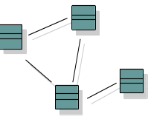

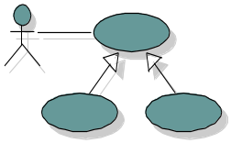
Software Architecture: The “4+1 View” Model
Logical View
Implementation View
Software management
Functionality
Use-Case View
Process View
Deployment View
Performance
Scalability
Throughput
System topology
Delivery, installation
communication
Notes:
Architecture is many things to many different interested parties. On a particular project,there are usually multiple stakeholders,each with their own concerns and view of the system to be developed.The goal is to provide each of these stakeholders with a view of the system that addresses their concerns, and suppresses the other details.
To address these different needs, rational has define the “4+1 view” architecture model.
The Logical View
This view of architecture addresses the functional requirements of the system-what the system should provide in terms of services to its users. The logical architecture is captured in class diagrams that contain the classes and relationships that represent the key abstractions of the system under development.
This view of architecture is addressed early in the elaboration phase with the creation of classes and packages that represent the major abstractions of the domain.
The Implementation View
This view of architecture concerns with the actual software module organization within the development environment. The implementation view of architecture takes into account derived requirements related to ease of development. software management, reuse and constraints imposed by programming languages and development tools. The modeling elements in the component view of architecture are packages and components along with their connections.
The Process View
This view of architecture focuses on the run-time implementation structure of the system. It takes into account requirements such as performance,reliability,scalability,integrity,system management and synchronization. Components are also used in this view. The component diagrams are created to view the run-time and executable components created for the system.
The Deployment View
This view of the architecture involves mapping software to processing nodes. It shows the configuration of run-time processing elements and the software processes living on them. It takes into account requirements such as system availability,reliability,performance and scalability. Deployment diagrams are created to show the different nodes along with their connections in the system.
The Use Case View
This view of architecture demonstrates and validates the logical process, component and deployment views. Sequence diagrams and collaboration diagrams are created to show how the various design elements interact to produce the desired behavior.

Slide 131
UML DIAGRAMS

Slide 132
UML – What it is?
By quote,
The Unified Modeling Language (UML) is a language for
specifying,
visualizing,
constructing,
documenting
the artifacts of software systems, as well as for business modeling
and other non-software systems
Page <number>

Slide 133
Modeling
Definition of Modeling
Modeling is a central part of all the activities that lead up to the deployment of good software. Model is a simplification of reality.
Need for building models
We build models to
  Communicate the desired structure and behaviour of our system
  Visualize and control the system’s architecture
  Better understand the system we are building, often exposing opportunities for simplification and reuse.
  Manage risk
  Modeling is a proven and well-accepted engineering technique. It documents the decisions we have made
Page <number>

Slide 134
UML – What it is ?
The Unified Modeling Language was originally developed at Rational Software but is now administered by the Object Management Group . It is a modeling syntax aimed primarily at creating models
It is:
Syntax only
Comprehensive
Language independent
Process independent
Tool independent
Page <number>
Notes:
Features of UML
Syntax only - UML is just a language, it tells you what model elements and diagrams are available and the rules associated with them. It doesn't
tell you what diagrams to create.
Comprehensive - it can be used to model anything. It is designed to be user extended to fill any modelling requirement.
Language independent - it doesn't matter what hi-level language is to be used in the code. Mapping into code is a matter for the case tool you use.
Process independent - the process by which the models are created is separate from the definition of the language. You will need a process in addition to the use of UML itself.
Tool independent - UML leaves plenty of space for tool vendors to be creative and add value to visual modelling with UML. However, some tools will be better than others for particular applications.
Well documented - the UML notation guide is available as a reference to all the syntax available in the language.
Its application is not well understood - the UML notation guide is not sufficient to teach you how to use the language. It is a generic modelling language and needs to be adapted by the user to particular applications.
Originally just for system modelling –
some user defined extensions are becoming more widely used now, for example for business modelling and modelling the design of web-based applications.

Slide 135
Where can the UML be used
UML is intended primarily for software-intensive systems.
It is used effectively for such domains as
  Banking & financial services
  Telecommunications
  Transportation
  Defence/aerospace
  Medical electronics
  Distributed Web-based services
UML is expressive enough to model non-software systems also, such as workflow in the legal system,healthcare system and hardware design
Page <number>

Slide 136
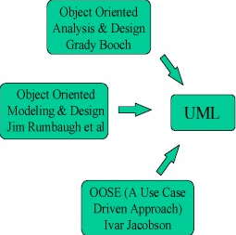
How UML Started?
Page <number>
Notes:
UML came about when James Rum Baugh joined Grady Booch at Rational Software. They both had object oriented syntaxes and needed to combine them. Semantically they were very similar, it was mainly the symbols that needed to be unified. The result was UML 1.0
Then Ivar Jacobson joined them. He brought with him the syntax for use cases which was added in UML 1.1. The Object Management Group adopted the UML1.1 specification in November 1997 making it an independent industry standard.Some small changes were made in in versions 1.3 and 1.4. Version 2.0 is currently being researched.

Slide 137
Building Blocks of the UML
The vocabulary of the UML encompasses 3 kinds of building blocks
1) Things – these are abstractions in a model
    Structural Behaviour
    Grouping Annotational
2) Relationships – these tie/ bind the things together
3) Diagrams – these group the interesting collections of things
    Class Diagram Object Diagram
    Use Case Diagram Sequence Diagram
    Collaboration Diagram State Chart Diagram
    Activity Diagram Component Diagram
    Deployment Diagram
Page <number>

Slide 138
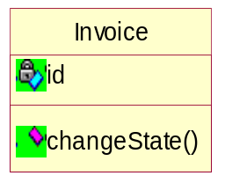
Structural Things
Structural things are the nouns of UML models.
These are mostly static parts of a model, representing elements that are either conceptual or physical
The elements of structural things
Class
Interface
Collaborations
Class Name
Attributes
Operations
ISpelling
Chain of responsibility
Page <number>
Notes:
The elements of structural things
Class –
It is a description of a set of objects that share the same attributes, operations ,relationships and semantics. A class implements one or more
interfaces.
2) Interface –
An interface is a collection of operations that specify a service of a class or component. An interface therefore describes the externally
visible behaviour of that element.It defines a set of operations but never implements it.
3) Collaboration –
A collaboration defines an interaction and is a society of roles and other elements that work together to provide some cooperative behaviour
that’s bigger than the sum of all the elements. So collaborations have both structural and behavioural dimensions.

Slide 139
Structural Things
Place Order
4) Use Case
5) Active Class
6) Component
7) node
Event Manager
Suspend()
Flush()
Order form.java
Server
Page <number>
Notes:
4) Use Case –
A use case is a description of set of actions that a system performs that yields an observable result of value to a particular actor.It is used to
structure the behavioural things in a model. A use case is realized by a colloboration.
5) Active Class –
An active class is a class whose objects own one or more processes or threads and therefore can initiate control activity. An active class is just like a class except that its objects represent elements whose behaviour is concurrent with other elements.
6) Component –
A component is a physical and replaceable part of a system that conforms to and provides the realization of a set of interfaces.A component
typically represents the physical packaging of otherwise logical elements such as classes, interfaces and collaborations.
7) Node –
A node is a physical element that exists at runtime and represents a computational resource, generally yhaving at least some memory and
often processing capability.

Slide 140
Behavioural Things
Behavioural things are dynamic parts of UML models. These are the
verbs of a model, representing behaviour over time and space.
Elements of a behavioural things
Interaction
2) State machines
display
Waiting
Page <number>
Notes:
Elements of a behavioural things
Interaction –
an interaction is a behaviour that comprises a set of messages exchanged among a set of objects within a particular context to accomplish a specific purpose.
State machines –
A state machine is a behaviour that specifies the sequence of states an object or an interaction goes through during its lifetime in response
to events,together with its responses to those events.

Slide 141
Grouping Things
Grouping things are the organizational parts of UML models. These are the boxes into which a model can be decomposed.
Packages
Business Rules
Page <number>
Notes:
Packages –
A package is a general – purpose mechanism for organizing elements into groups. Structured things, behavioural things and even other grouping things may be placed in a package.
Graphically , a package is rendered as a tabbed folder,usually including only its anme and sometimes its contents.
Packages are the basic grouping things with which you may organize a UML model. There are also variations, such as frameworks,models and subsystems (kinds of packages)

Slide 142
Annotational Things
Annotational things are the explanatory parts of the UML models. These are the comments you may apply to describe, illuminate and remark about any element in a model.
Note
Return copy of self
Page <number>
Notes:
Note –
A note is simply a symbol for rendering constraints and comments attached to an element or a collection of elements.
Graphically, a note is rendered as a rectangle with a dog-eared corner,together with a textual or graphical comment.
You will typically use notes to adorn your diagrams with constraints or comments that are best expressed in informal or formal text.

Slide 143
Relationships in the UML
The 4 kinds of relationships in the UML are –
Association
Dependency
Realization
Generalization
Page <number>
Notes:
Dependency –
A dependency is a semantic relationship between two things in which a change to one thing(the independent thing) may effect the semantics of the other thing(the dependent thing).Graphically , a dependency is rendered as a dashed line, possibly directed, and occasionally including a label.
Association –
An assciation is a structural relationship that describes a set of links, a link being a connection among objects. Aggregation is a special kind of association, representing a structural relationship between a whole and its parts.Graphically, is is rendered as a solid line , possibly directed, occasionally including a label, and often containing other adornments, such as multiplicity and role names.
Generalization –
A generalization is a specialization/generalization relationship in which objects of the specialized element (the child) are substitutable for objects of the generalized element (the parent). In this way, the child shares the structure and the behaviour of the parent. Graphically, a generalization relationship is rendered as a solid line with a hollow arrowhead pointing to the parent.
Realization –
A realization is a semantic relationship between classifiers,wherein one classifier specifies a contract that another classifier guarantees to carry out. Realization relationships is encountered in 2 places.
Between interfaces and the classes or components that realize them.
Between use cases and the collaborations that realize them.
Graphically, a realization relationship is rendered as a cross between generalization and a dependency relationship.

Slide 144

Association
Association is a semantic relationship between two or more classifiers that specifies connections among their instances
Association
Eg,
Navigability
Eg,
Multiplicity
Eg,
Person
+Employee
Works for
+Employer
Company
n
1
OrderDetail
Item
0..*
0..*
1
1
Page <number>
Notes:
Association:
Association is a semantic relationship between two or more classifiers that specifies connections among their instances. There is an association between two classes if an instance of one class must know about the other in order to perform its work. In a diagram, an association is a link connecting two classes. An association relationship should be a solid line if both classes are aware of each other and a line with an open arrowhead if the association is known by only one of the classes.
An association has two ends. An end may have a Role Name to clarify the nature of the association. For example, a Person is an Employee of the Company.
A navigability arrow on an association shows which direction the association can be traversed or queried. An OrderDetail can be queried about its Item, but not the other way around. The arrow also lets you know who "owns" the association's implementation; in this case, OrderDetail has an Item. Associations with no navigability arrows are bi-directional.
The multiplicity of an association end is the number of possible instances of the class associated with a single instance of the other end. Multiplicities are single numbers or ranges of numbers. In the following example, there can be only one Customer for each Order, but a Customer can have any number of Orders.

Slide 145

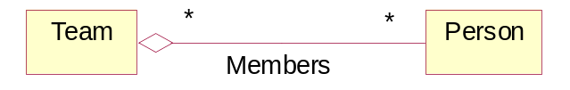
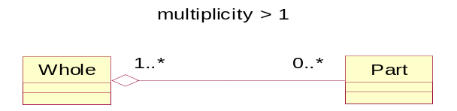


Association Contd - Aggregation
Aggregation: Aggregation is a special form of Association, which models a Whole-Part relationship between an Aggregate (the Whole) and its Parts.
Shared Aggregation:
Non-shared aggregation – composition:
Page <number>
Notes:
Aggregation:
Aggregation is a special form of Association, which models a Whole-Part relationship between an Aggregate (the Whole) and its Parts. It is an association in which one class belongs to a collection. The Use of Multiplicity, roles, navigation is the same as for Association. An aggregation has a diamond end pointing to the part containing the whole.
Example:
- Navy contains many Warships
- Some warships can be removed-still it is navy
- Multiplicity, Roles & Qualifiers are allowed
- It is a normal Aggregation
Shared Aggregation:
- Parts may be parts in any Whole
- A team is composed of Team members
- One Person could be a member of many Teams
- Aggregation is shared if multiplicity on Whole side is other than 1
- Destroying the aggregate does not necessarily destroy the parts
- Shared aggregation forms a graph or a tree with many roots
- With regard to registration, a Student does not make sense outside the context of University.
- Student may be enrolled in classes in multiple Universities
Non-shared aggregation – composition:
Composition is non-shared Aggregation, where Parts “live” inside the whole and the parts will be destroyed together with its whole. An object may be a part of only one composite at a time.
- A Frame belongs to exactly one window
- A Wall Object may be a part of one or more room objects
In a composition, the Whole is responsible for the disposition of its parts. The Composite must manage the creation & destruction of its parts.
Eg. When you create a Frame in a Windowing system, you must attach it to an enclosing Window. When you destroy the window, the Window object must in turn destroy its Frame parts

Slide 146

Dependency
A dependency is a semantic relationship between two things in which a change to one thing (Independent thing) may affect the semantics of the other thing (Dependent).
Page <number>
Notes:
Dependency:
A dependency is a semantic relationship between two things in which a change to one thing (Independent thing) may affect the semantics of the other thing (Dependent).
Sometimes the relationship between a two classes is very weak. They are not implemented with member variables at all. Rather they might be implemented as member function arguments. Consider, for example, the add function of the CourseSchedule class. Suppose that this function takes an argument of type Course. The arrow shape between the CourseSchedule and the Course is the Dependency relationship. This relationship simply means that CourseSchedule somehow depends upon Course.

Slide 147
Realization
In a realization relationship, one entity (normally an interface) defines a set of functionalities as a contract and the other entity (normally a class) "realizes" the contract by implementing the functionality defined in the contract.
HTML Parser
Parser
Page <number>

Slide 148

Generalization
Generalization is the basic type of relationship used to define reusable elements in the class diagram. Literally, the child classes "inherit" the common functionality defined in the parent class. It is an inheritance link indicating one class is a superclass of the other. A generalization has a triangle pointing to the superclass. Payment is a superclass of Cash, Check, and Credit.
Page <number>

Slide 149
UML Diagrams
UML is a modeling language for specifying, visualizing, constructing, and documenting the artifacts of a system-intensive process. This guide introduces you to the 9 standard diagrams in the UML 1.4 specification. These diagrams can be divided into two groups: Structural diagrams, which model the organization of the solution, and Behavioral diagrams, which model the functionality of the solution.
  Structural Diagrams
    Class Diagram
    Object Diagram
    Implementation Diagram
      Component Diagram
      Deployment Diagram
  Behavioral Diagrams
    Use Case Diagram
    Interaction Diagrams
      Sequence Diagram
      Collaboration Diagram
    StateChart Diagram
    Activity Diagram

Slide 150
UML Diagrams
Class Diagram
It shows a set of classes,interfaces and collaborations and their relationships.
Class diagrams address the static design view of a system.
Object Diagram
An object diagram shows a set of objects and their relationships.
The y represent static snapshots of instances of the things found in the class diagram
Page <number>

Slide 151
UML Diagrams
Interaction Diagram
It shows an interaction,consisting of a set of objects and
their relationships,including the messages that may be
dispatched among them.
Sequence Diagram
It is an interaction diagram that emphasizes the time-ordering of messages.
2) Collaboration Diagram
It is an interaction diagram that emphasizes the structural organizational of the objects that send and receive messages.
Page <number>

Slide 152
UML Diagrams
Statechart Diagram
It shows a state machine, consisting of states,transitions,events and activities.
It addresses the dynamic view of the system.
Specially important for modelling the behaviour of an interface,class, or collaboration and emphasize the event-ordered behaviour of an object.
Page <number>

Slide 153
UML Diagrams
Activity Diagram
It is a special kind of a statechart diagram that shows the flow from activity to activity within a system.
It addresses the dynamic view of a system
Especially important in modeling the function of a system and emphasize the flow of control among objects
Page <number>

Slide 154
UML Diagrams
Component Diagram
It shows the organizations and dependencies among a set of components.
These address the static implementation view of a system
They are related to class diagrams in that a component typically maps to one or more classes, interfaces or collaborations.
Page <number>

Slide 155
UML Diagrams
Deployment Diagram
It shows the configuration of run-time processing nodes and the components that live on them.
These address the static deployment view of an architecture.
They are related to component diagrams in that a node typically encloses one or more components.
Page <number>

Slide 156
Use Case Diagram
Use Case diagrams identify the functionality provided by the system (use cases), the users who interact with the system (actors), and the association between the users and the functionality. Use Cases are used in the Analysis phase of software development to articulate the high-level requirements of the system. The primary goals of Use Case diagrams include:
  Providing a high-level view of what the system does
  Identifying the users ("actors") of the system
  Determining areas needing human-computer interfaces

Slide 157
Use Case Diagram –Terms and Concepts
A use case diagram is a diagram that shows a set of use cases and actors and their relationships.
Use case diagrams commonly contain
  Use cases
  Actors
  Dependency, generalization, and association relationships
Like all other diagrams, use case diagrams may contain notes and constraints.
Use case diagrams may also contain packages, which are used to group elements of your model into larger chunks

Slide 158


Use Case Diagram - Notations
Term | Description | Notation
Actor | An Actor, as mentioned, is a user of the system, and is depicted using a stick figure. The role of the user is written beneath the icon. Actors are not limited to humans. If a system communicates with another application, and expects input or delivers output, then that application can also be considered an actor.
Use Case | A Use Case is functionality provided by the system, typically described as verb+object (eg. Register Car, Delete User). Use Cases are depicted with an ellipse. The name of the use case is written within the ellipse.
Association | Associations are used to link Actors with Use Cases, and indicate that an Actor participates in the Use Case in some form. Associations are depicted by a line connecting the Actor and the Use Case.

Slide 159
Use case diagram -example
A Simple telephone system
Place local call
Caller
Callee
Place long-distance Call
Retrieve Customer Billing Information
Billing system
Get Call History
Customer
System Boundary

Slide 160

Use Case Diagrams
Use Case Diagram show the functionality of the system from an outside-in viewpoint.
These include
Actors
Use Cases
Solid lines
Dotted lines
Why and When to Apply?
Page <number>
Notes:
Actors (stick men) are anything outside the system that interacts with the system.
Use Cases (ovals) are the procedures by which the actors interact with the system
Solid lines indicate which actors interact with the system as part of which procedures
Dotted lines show dependencies between use cases, where one use case is 'included' in or 'extends' another.
Why and When to apply
Writing use cases is an excellent technique to understand and describe requirements.
It is a model of the system’s functionality and environment.
Use cases are identified and created during the Requirements phase of the S/W systems

Slide 161

Use Case Diagram Contd
Case Study – Process Sale
Page <number>

Slide 162
Use Case Diagram – Common Use
You apply use case diagrams to model the static use case view of a system.
When you model the static use case view of a system, you'll typically apply use case diagrams in one of two ways.
  To model the context of a system
  To model the requirements of a system
Notes:
When you model the static use case view of a system, you'll typically apply use case diagrams in one of two ways.
To model the context of a system
Modeling the context of a system involves drawing a line around the whole system and asserting which actors lie outside the system and interact with it.Here, you'll apply use case diagrams to specify the actors and the meaning of their roles.
To model the requirements of a system
Modeling the requirements of a system involves specifying what that system should do (from a point of view of outside the system), independent of how that system should do it. Here, you'll apply use case diagrams to specify the desired behavior of the system. In this manner, a use case diagram lets you view the whole system as a black box; you can see what's outside the system and you can see how that system reacts to the things outside, but you can't see how that system works on the inside.

Slide 163
Use Case Diagram – Points to Note
A well-structured use case diagram
  Is focused on communicating one aspect of a system's static use case view.
  Contains only those use cases and actors that are essential to understanding that aspect.
  Provides detail consistent with its level of abstraction; you should expose only those adornments (such as extension points) that are essential to understanding.
  Is not so minimalist as to misinform the reader about semantics that are important.
When you draw a use case diagram,
  Give it a name that communicates its purpose.
  Lay out its elements to minimize lines that cross.
  Organize its elements spatially so that behaviors and roles that are semantically close are laid out physically close.
  Use notes and color as visual cues to draw attention to important features of your diagram.
  Try not to show too many kinds of relationships. In general, if you have complicated include and extend relationships, take these elements to another diagram.

Slide 164

Exercise – Course Registration System

Slide 165
Class Diagrams
Class diagrams identify the class structure of a system, including the properties and methods of each class. Also depicted are the various relationships that can exist between classes, such as an inheritance relationship. The Class diagram is one of the most widely used diagrams from the UML specification.
Part of the popularity of Class diagrams stems from the fact that many CASE tools, such as Rational XDE, will auto-generate code in a variety of languages, including Java, C++, and C#, from these models. These tools can synchronize models and code, reducing your workload, and can also generate Class diagrams from object-oriented code, for those "code-then-design" maintenance projects.

Slide 166
Class Diagrams
Class diagrams commonly contain the following things
Classes
Interfaces
Collaborations
Dependency, generalization and association relationships.
Class diagrams may also contain packages or subsystems, both of which
are used to group elements of your model into larger chunks.
Note: Component diagrams and deployment diagrams are similar to
class diagrams, except that instead of containing classes, they contain
components and nodes, respectively.

Slide 167
Class Diagrams
Terms and Concepts
A class diagram is a diagram that shows a set of classes, interfaces and collaborations and their relationships.
Common Properties
It is a special kind of diagram and shares the same common properties as do all other diagrams- a name and graphical content that are a projection into a model.
Contents
Class diagrams commonly contain the following
  Classes
  Interfaces
  Collaborations
  Dependency, generalization and association relationships

Slide 168

Notations

Slide 169

Class Diagrams
Class diagrams show the static structure of the systems. Classes define the properties of the objects which belong to them.
These include
Attributes
Operations
Associations
Page <number>
Notes:
Attributes - (second container) the data properties of the classes including type, default value and constraints
Operations - (third container) the signature of the functionality that can be applied to the objects of the classes including parameters, parameter types, parameter constraints, return types and the semantics.
Associations - (solid lines between classes) the references contained within the objects of the classes to other objects enabling interaction with those objects.

Slide 170

Class Diagram Contd
Page <number>

Slide 171
Common Use of Class diagrams
You use class diagram to model the static design view of a system. This
view primarily supports the functional requirements of a system – the
services the system should provide to its end users.
Class diagrams are typically used in one of the three ways.
To model the vocabulary of a system.
To model simple collaborations
To model a logical database schema.
Notes:
To model the vocabulary of a system.
Modeling the vocabulary of a system involves making a decision about which abstractions are a part of the system under consideration and which fall outside its boundaries. You use class diagrams to specify these abstractions and their responsibilities.
To model simple collaborations
A collaboration is a society of classes, interfaces and other elements that work together to provide some cooperative behavior that’s bigger than the sum of all the elements. For eg,when you’re modeling the semantics of a transaction in a distributed system, you can’t just stare at a single class to understand what’s going on.Rather,these semantics are carried out by a set of classes that work together. You use class diagrams to visualize and specify this set of classes and their relationships.
To model a logical database schema.
Think of a schema as the blueprint for the conceptual design of a database. In many domains, you'll want to store persistent information in a relational database or in an object-oriented database. You can model schemas for these databases using class diagrams.

Slide 172
Points to note – on Class diagrams
A well-structured class diagram
Is focused on communicating one aspect of a system’s static design view.
Contains only elements that are essential to understanding that aspect.
Provides detail consistent with its level of abstraction, with only those adornments that are essential to understanding.
Is not so minimalist that it misinforms the reader about important semantics

Slide 173
Points to note – on Class diagrams
When you draw a class diagram,
Give it a name that communicates its purpose.
Lay out its elements to minimize lines that cross
Organize its elements so that things that are semantically close are laid out physically close
Use notes and color as visual cues to draw attention to important features of your diagram.
Try not to show too many kinds of relationships. In general, one kind of relationship will tend to dominate each class diagram

Slide 174
Object Diagrams
Object diagrams model instances of classes. An object diagram shows a set of objects and their relationships at a point in time.
Object diagrams are used to model the static design view or static process view of a system. This involves modeling a snapshot of the system at a moment in time and rendering a set of objects, their state, and their relationships.
Object diagrams are not only important for visualizing,specifying,and documenting structural models, but also for constructing the static aspects of systems through forward and reverse engineering.
From a notation standpoint, Object diagrams borrow elements from Class diagrams.

Slide 175
Object Diagrams
With the UML,you use class diagrams to visualize the static aspects of your system’s building blocks. You use interaction diagrams to visualize the dynamic aspects of your system, consisting of instances of these building blocks and messages dispatched among them. An object diagram covers a set of instances of the things found in a class diagram. An object diagram therefore expresses the static part of an interaction, consisting of the objects that collaborate, but without any of the messages passed among them.

Slide 176

Notations
Often, object diagrams use simpler notation than their class diagram counterparts, to focus on the instances of objects and not the relationships between classes (including inheritance). Many Object diagrams are diagrammed using only Objects and Associations.

Slide 177
Object Diagrams
Terms and Concepts
An object diagram is a diagram that shows a set of objects and their
relationships at a point of time.
Contents
Object diagrams commonly contain
Objects
Links
Note:
An object diagram is essentially an instance of a class diagram or the
static part of an interaction diagram. In either case, an object diagram
contains primarily objects and links, and focuses on concrete or
prototypical instances.

Slide 178
Object diagrams
Common Uses
You use object diagrams to model the static design view or the static
process view of a system just as you do with class diagrams, but from
the perspective of real or prototypical instances. This view primarily
supports the functional requirements of a system-that is , the services
the system should provide to its end users.
When you model the static design view or the static process view of a
system, you typically use object diagrams
To model object structures
Notes:
To model object structures
Modeling object structures involves taking a snapshot of the objects in a system at a given moment in time. You use object diagrams to visualize,specify,construct and document the existence of certain instances in your system, together with their relationships to one another.

Slide 179

Object Diagram
Object diagrams show instances instead of classes. They are useful for explaining small pieces with complicated relationships, especially recursive relationships.
This small class diagram shows that a university Department can contain lots of other Departments.
Page <number>

Slide 180

Object Diagram Contd
The object diagram below instantiates the class diagram, replacing it by a concrete example.
Page <number>

Slide 181
Points to note – on Object diagrams
A well structured object diagram
Is focused on communicating one aspect of a system’s static design view or static process view
Represents one frame in the dynamic storyboard represented by an interaction diagram
Contains only those elements that are essential to understanding that aspect
Provides detail consistent with its level of abstraction;you should expose only those attribute values and other adornments that are essential to understanding

Slide 182
Points to note – on Object diagrams
When you draw an object diagram,
Give it a name that communicates its purpose
Lay out its elements to minimize lines that cross
Organize its elements so that things that are sematically close are laid out to be physically close
Use notes and color as visual cues to draw attention to important features of your diagram
Include the values,state,and role of each object as necessary to communicate your intent.

Slide 183
Interaction Diagrams
Terms and Concepts
An interaction is a behavior that comprises a set of messages exchanged among a set of objects within a context to accomplish a purpose. A message is a specification of a communication between objects that conveys information with the expectation that activity will ensue.
Note:
Sequence diagrams and collaboration diagrams – both of which are called interaction diagrams- are two of the five diagrams used in the UML.
Notes:
Interactions
You may find an interaction wherever objects are linked to one another. You'll find interactions in the collaboration of objects that exist in the context of your system or subsystem. You will also find interactions in the context of an operation. Finally, you'll find interactions in the context of a class.
You'll also find interactions among objects in the implementation of an operation. The parameters of an operation, any variables local to the operation, and any objects global to the operation (but still visible to the operation) may interact with one another to carry out the algorithm of that operation's implementation
Finally, you will find interactions in the context of a class. You can use interactions to visualize, specify, construct, and document the semantics of a class
Note
An interaction may also be found in the representation of a component, node, or use case, each of which, in the UML, is really a kind of classifier. In the context of a use case, an
interaction represents a scenario that, in turn, represents one thread through the action of the use case

Slide 184
Interaction Diagrams – Terms & Concepts
An interaction diagram shows an interaction, consisting of a set of objects and their relationships, including the messages that may be dispatched among them.
Sequence diagrams and collaboration diagrams – both of which are called interaction diagrams- are two of the five diagrams used in the UML.
Sequence Diagram
It is an interaction diagram that emphasizes on the time ordering of messages
Collaboration Diagram
It is an interaction diagram that emphasizes the structural organization of the objects that send and receive messages

Slide 185
Interaction Diagrams – Contents
Interaction diagrams commonly contain
Objects
Links
Messages
Note:
An interaction diagram is basically a projection of the elements found in an interaction. The semantics of an interaction’s context, objects and roles,links,messages and sequencing apply to interaction diagrams.
Notes:
Objects and Roles
The objects that participate in an interaction are either concrete things or prototypical things. As a concrete thing, an object represents something in the real world. For example, p, an instance of the class Person, might denote a particular human. Alternately, as a prototypical thing, p might represent any instance of Person.
Note:
This is what distinguishes a collaboration. In a collaboration, the objects you find are prototypical things that play particular roles, not specific objects in the real world.
Links
A link is a semantic connection among objects. In general, a link is an instance of an association.Whereever a class has an association to another class, there may be a link between the instances of the two classes; wherever there is a link between two objects;oneobject can send a message to the other object.
A link specifies a path along which one object can dispatch a message to another object.
Messages
A message is a specification of a communication among objects that conveys information with the expectation that activity will ensue. The receipt of a message instance may be considered an instance of an event. When you pass a action that results is an executable statement that forms an abstraction of a computational procedure. An action may result in a change in state.
In the UML,you can model several kinds of actions.
Call – Invokes an operation on an object; an object may send a message to itself, resulting in the local invocation of an operation.
Return – Returns a value to the caller
Send – sends a signal to an object
Create – Creates an object
Destroy – Destroys an object; an object may commit suicide by destroying itself.

Slide 186
Interaction Diagrams – Common Uses
You use interaction diagrams to model the dynamic aspects of the system. These dynamic aspects may involve the interaction of any kind of instance in any view of a system’s architecture, including instances of classes,interfaces,components and nodes.
Interaction diagrams are used
  To model flows of control by time ordering
  To model flows of control by organization
Notes:
To model flows of control by time ordering
Here you will use sequence diagrams. Modeling a flow of control by time ordering emphasizes the passing of messages as they unfold over time, which is a particularly useful way to visualize dynamic behavior in the context of a use case scenario. Sequence diagrams do a better job of visualizing simple iteration and branching than do collaboration diagrams.
To model flows of control by organization
Here you will use collaboration diagrams. Modeling a flow of control by organization emphasizes the structural relationships among the instances in the interaction , along which messages may be passed. Collaboration diagrams do a better job of visualizing complex iteration and branching and of visualizing multiple concurrent flows of control than do sequence diagrams.

Slide 187
Representation of Sequence Diagram
Graphically sequence diagram is table that shows objects arranged along the X axis and messages, ordered in increasing time along the Y axis.
Sequence diagrams are read from left to right.
First you place all participating objects at the top of your diagram across X axis
Next you place the messages that these objects send & receive along the Y axis in order of increasing time from top to bottom.

Slide 188
Sequence diagram.
Two distinguishing features.
  Object lifeline
  Focus of control

Slide 189




Sequence Diagram Representation
Notation | Description
Class roles | A View of the class that helps to achieve a particular functionality.
Actor | The actors start a sequence by acting upon the system.
Message | Ideally a method call between two classes.
Lifeline | Denotes the life span of a method call.
Loops | These are self calls; when a object makes a call to itself to get some info

Slide 190

Sequence Diagrams contd’…

Slide 191

eg – Sequence Diagram

Slide 192

Exercise : Online Stock Broker System
Notes:
A sequence model elaborates the themes of use cases. There are two kinds of sequence models: scenarios and a more structured format called sequence diagrams.
Scenario
A scenario is a sequence of events that occurs during one particular execution of a system,such as for a use case.
A scenario can be displayed as a list of text statements.
For eg :
A customer logs on with an online stock broker system,places an order for XYZ stock,and then logs off.Sometime later,after the order is executed,the securities exchange reports the results of the trade to the broker system.
Scenario
Customer logs in
System establishes secure communications
System displays portfolio information
Customer enters a buy order for 100 shares of XYZ at the market price
System verifies sufficient funds for purchase
System displays confirmation screen with estimated cost
Customer confirms purchase
System places order on securities exchange
System displays transaction tracking number
Customer logs out
System establishes insecure communication
System displays good bye screen
Securities exchange reports results of trade
Sequence Diagram
A sequence diagram shows the participants in an interaction and the sequence of messages among them.A sequence diagram shows the interaction of a system with its actors to perform all or part of a use case.

Slide 193

Example – ATM Process Transaction – Withdrawal Scenario

Slide 194
Collaboration Diagram
Interaction diagram.
Structural organizations of objects that send and receive messages.
Sequence and collaboration diagrams are isomorphic.

Slide 195
Collaboration diagram.
Place objects as vertices in a graph.
Render links connecting objects as arcs.
Adorn these links with messages that objects send and receive.
Two distinguishing features.
  Path. (local,parameter,global,self)
  sequence number - indicate time order of message.

Slide 196


Representation of Collaboration Diagrams
Term | Description | Notation
Object | Objects are instances of classes, and are one of the entity types that can be involved in communications. An Object is drawn as a rectangular box, with the class name inside prefixed with the object name (optional) and a semi-colon.
Actor | Actors can also communicate with Objects, so they too can be listed on Collaboration diagrams. An Actor is depicted by a stick figure.
Message | Messages, modeled as arrows between objects, and labeled with an ordering number, indicate the communications between objects.
Notes:
Objects
Objects are instances of classes, and are one of the entity types that can be involved in communications. An Object is drawn as a rectangular box, with the class name inside prefixed with the object name (optional) and a semi-colon
Actor
Actors can also communicate with Objects, so they too can be listed on Collaboration diagrams. An Actor is depicted by a stick figure.
Messages
Messages, modeled as arrows between objects, and labeled with an ordering number, indicate the communications between objects.

Slide 197

Collaboration Diagram
Place all participating objects as the vertices in a graph.
Render the links that connect these objects as the arcs of this graph.
Adorn these links with the messages that objects send and receive.

Slide 198
Points to note – on Interaction diagrams
A well structured interaction diagram
Is focused on communicating one aspect of a system’s dynamics.
Contains only those elements that are essential to understanding that aspect
Provides detail consistent with its level of abstraction;and should expose only those adornments that are essential to understanding.
Is not so minimalist that it misforms the reader about semantics that are important.

Slide 199
Points to note – on Interaction diagrams
When you draw an interaction diagram,
Give it a name that communicates its purpose
Use a sequence diagram if you want to emphasize the time ordering of messages. Use a collaboration diagram if you want to emphasize the organization of the objects involved in the interaction.
Lay out its elements to minimize lines that cross
Use notes and color as visual cues to draw attention to important features of your diagram
Using branching sparingly; you can represent complex branching much better using activity diagrams.

Slide 200
Activity Diagrams
Activity diagrams are one of the five diagrams in the UML for modeling the dynamic aspects of systems. An activity diagram is essentially a flowchart, showing flow of control from activity to activity.
You use activity diagrams to model the dynamic aspects of a system
With an activity diagram, you can also model the flow of an object as it moves from state to state at different points in the flow of control
An activity is an ongoing execution within a state machine. Activities ultimately result in some action, which is made up of executable computations that results in a change in state of the system or the return of a value.

Slide 201



Activity Diagrams – Terms and Notations
Term | Description | Notation
Activity States | Activity states mark an action by an object. The notation for these states are rounded rectangles, the same notation as found in Statechart diagrams.
Transition | When an Activity State is completed, processing moves to another Activity State. Transitions are used to mark this movement. Transitions are modeled using arrows.
Swimlane | Swimlanes divide activities according to objects by arranging objects in column format and placing activities by that object within that column. Objects are listed at the top of the column, and vertical bars separate the columns to form the swimlanes.
Initial State | The Initial State marks the entry point and the initial Activity State. The notation for the Initial State is the same as in Statechart diagrams, a solid circle. There can only be one Initial State on a diagram.
Final State | Final States mark the end of the modeled workflow. There can be multiple Final States on a diagram, and these states are modeled using a solid circle surrounded by another circle.
Synchronization Bar | Activities often can be done in parallel. To split processing ("fork"), or to resume processing when multiple activites have been completed ("join"), Synchronization Bars are used. These are modeled as solid rectangles, with multiple transitions going in and/or out.

Slide 202
Terms & Concepts
An activity diagram shows the flow from activity to activity.
An activity is an ongoing execution within a state machine.
Activities ultimately result in some action, which is made up of executable computations that result in a change in state of the system or the return of a value.
Actions encompass calling another operation, sending a signal, creating or destroying an object, or some pure computation, such as evaluating an expression.

Slide 203
Contents
Activity diagrams commonly contain
Activity states and action states
Transitions
Objects
Notes:
Action States and Activity States
In the flow of control modeled by an activity diagram, things happen. You might evaluate some expression that sets the value of an attribute or that returns some value. Alternately, you might call an operation on an object, send a signal to an object, or even create or destroy an object. These executable, atomic computations are called action states because they are states of the system, each representing the execution of an action
Transitions
When the action or activity of a state completes, flow of control passes immediately to the next action or activity state. You specify this flow by using transitions to show the path from one action or activity state to the next action or activity state. In the UML, you represent a transition as a simple directed line
Branching
Simple, sequential transitions are common, but they aren't the only kind of path you'll need to model a flow of control. As in a flowchart, you can include a branch, which specifies alternate paths taken based on some Boolean expression. A branch may have one incoming transition and two or more outgoing ones. On each outgoing transition, you place a Boolean expression, which is evaluated only once on entering the branch.
Forking and Joining
Simple and branching sequential transitions are the most common paths you'll find in activity diagrams. However—especially when you are modeling workflows of business processes—you might encounter flows that are concurrent. In the UML, you use a synchronization bar to specify the forking and joining of these parallel flows of control. A synchronization bar is rendered as a thick horizontal or vertical line.

Slide 204

Example – House Construction
Initial state
Action state
Sequential branching
Concurrent forking
Activity state
Concurrent joining
Final state

Slide 205

Example : Stock trading processing

Slide 206

Swimlanes - Processing an order example
Swimlanes
O: Order
[In progress]
O: Order
[filled]
b:Bill
b:Bill
[paid]
Notes:
Swimlanes
You'll find it useful, especially when you are modeling workflows of business processes, to partition the activity states on an activity diagram into groups, each group representing the business organization responsible for those activities. In the UML, each group is called a swimlane because, visually, each group is divided from its neighbor by a vertical solid line . A swimlane specifies a locus of activities. A swimlane is a kind of package .
Each swimlane has a name unique within its diagram. A swimlane really has no deep semantics, except that it may represent some real-world entity. Each swimlane represents a high-level responsibility for part of the overall activity of an activity diagram, and each swimlane may eventually be implemented by one or more classes. In an activity diagram partitioned into swimlanes, every activity belongs to exactly one swimlane, but transitions may cross lanes.
Object Flow
Objects may be involved in the flow of control associated with an activity diagram. For example, in the workflow of processing an order in the figure, the vocabulary of your problem space will also include such classes as Order and Bill. Instances of these two classes will be produced by certain activities (Process order will create an Order object, for example); other activities may modify these objects (for example, Ship order will change the state of the Order object to filled).
As the figure shows, you can specify the things that are involved in an activity diagram by placing these objects in the diagram, connected using a dependency to the activity or transition that creates, destroys, or modifies them. This use of dependency relationships and objects is called an object flow because it represents the participation of an object in a flow of control.

Slide 207
Activity Diagrams – Common Uses
When you model the dynamic aspects of a system, you'll typically use
activity diagrams in two ways.
To model a workflow
To model an operation
Notes:
To model a workflow
Here you'll focus on activities as viewed by the actors that collaborate with the system. Workflows often lie on the fringe of software-intensive systems and are used to visualize, specify, construct, and document business processes that involve the system you are developing. In this use of activity diagrams, modeling object flow is particularly important.
To model an operation
Here you'll use activity diagrams as flowcharts, to model the details of a computation. In this use of activity diagrams, the modeling of branch, fork, and join states is particularly important. The context of an activity diagram used in this way involves the parameters of the operation and its local objects.

Slide 208
Points to note – on Activity diagrams
A well-structured activity diagram
Is focused on communicating one aspect of a system's dynamics.
Contains only those elements that are essential to understanding that aspect.
Provides detail consistent with its level of abstraction; you expose only those adornments that are essential to understanding.
Is not so minimalist that it misinforms the reader about important semantics.

Slide 209
Points to note – on Activity diagrams
When you draw an activity diagram,
Give it a name that communicates its purpose.
Start with modeling the primary flow. Address branching, concurrency, and object flow as secondary considerations, possibly in separate diagrams.
Lay out its elements to minimize lines that cross.
Use notes and color as visual cues to draw attention to important features of your diagram.

Slide 210
StateChart Diagram
Statechart diagrams are one of the five diagrams in the UML for modeling the dynamic aspects of systems.
A statechart diagram shows a state machine.
An activity diagram is a special case of a statechart diagram in which all or most of the states are activity states and all or most of the transitions are triggered by completion of activities in the source state. Thus, both activity and statechart diagrams are useful in modeling the lifetime of an object.
An activity diagram shows flow of control from activity to activity, a statechart diagram shows flow of control from state to state.
You use statechart diagrams to model the dynamic aspects of a system.
Statechart diagrams may be attached to classes, use cases, or entire systems in order to visualize, specify, construct, and document the dynamics of an individual object.
Statechart diagrams commonly contain
  Simple states and composite states
  Transitions, including events and actions

Slide 211
Statechart diagram.
Shows a state machine, consisting of
  states
  transitions
  events
  activities.
Dynamic view of the system.
Modeling behavior of an interface,class or collaboration.
Emphasizes event ordered behavior of an object.

Slide 212

StateChart Diagram - Notations
Term | Description | Notation
State | The State notation marks a mode of the entity, and is indicated using a rectange with rounded corners, and the state name written inside.
Transition | A Transition marks the changing of the object State, caused by an event. The notation for a Transition is an arrow, with the Event Name written above, below, or alongside the arrow.
Initial State | The Initial State is the state of an object before any transitions. For objects, this could be the state when instantiated. The Initial State is marked using a solid circle. Only one initial state is allowed on a diagram.
Final State | End States mark the destruction of the object who's state we are modeling. These states are drawn using a solid circle with a surrounding circle.

Slide 213
StateChart Diagram – Terms and Concepts
Statechart diagram
State machine
State
Event
Transition
Activity
Action
Notes:
Statechart diagram
A statechart diagram shows a state machine, emphasizing the flow of control from state to state.
State machine
A state machine is a behavior that specifies the sequences of states an object goes through during its lifetime in response to events, together with its responses to those events.
State
A state is a condition or situation in the life of an object during which it satisfies some condition, performs some activity, or waits for some event.
Event
An event is the specification of a significant occurrence that has a location in time and space. In the context of state machines, an event is an occurrence of a stimulus that can trigger a state transition.
Transition
A transition is a relationship between two states indicating that an object in the first state will perform certain actions and enter the second state when a specified event occurs and specified conditions are satisfied.
A transition has five parts
Source State - The state affected by the transition;if an object is in the source state,an outgoing transition may fire when the object receives the trigger event of the transition and if the guard condition,if any,is satisfied.
Event Trigger – The event whose reception by the object in the source state makes the transition eligible to fire,providing its guard condition is satisfied
Guard condition – A boolean expression that is evaluated when the transition is triggered by the reception of the event trigger;if the expression evaluates True,the transition is eligible to fire;if the expression evaluates False,the transition does not fire and if there is no other transition that could be triggered by that same event,the event is lost.
Action – An executable atomic computation that may directly act on the object that owns the state machine,and indirectly on other objects that are visible to the object.
Target state – the state that is active after the completion of the transition.
Activity
An activity is ongoing execution within a state machine.
Action
An action is an executable atomic computation that results in a change in state of the model or the return of a value.

Slide 214

State Chart Diagram - Example
Transition to/from composite state
sequential substate
Composite state
Error/print report
State machines
event
Transition from substate
action
Notes:
Example - The ATM System – Modeling the behavior of an ATM
There are three basic states in which the system might be Idle (waiting for customer interaction) ,Active (handling a customer’s transaction ), and Maintenance ( perhaps having its cash store replenished). While Active, the behavior of the ATM follows a simple path: Validate the customer, select a transaction, process the transaction, and then print a receipt. After printing, the ATM returns to the Idle state. You might represent these stages of behavior as the states Validating,Selecting,Processing and Printing. Here the Active state has a substructure containing the sub states Validating,Selecting,Processing and Printing. The state of the ATM changes from Idle to Active when the customer enters a credit card in the machine. On entering the Active state, the entry action action read Card is performed. Starting with the initial state, then to the Selecting state, and then to the Processing state. After Processing, control may return to Selecting (if the customer has selected another transaction) or it may move on to Printing. After Printing, there's a triggerless transition back to the Idle state. Notice that the Active state has an exit action, which ejects the customer’s credit card. Notice that the transition from the Active state to the idle state, triggered by the event cancel. In any sub state of Active, the customer might cancel the transaction and that returns the ATM to the Idle state.

Slide 215
StateChart Diagrams – Common Use
When you model the dynamic aspects of a system, a class, or a use case, you'll typically use statechart diagrams in one way.
  To model reactive objects
A reactive – or event-driven – object is one whose behavior is best characterized by its response to events dispatched from outside its context. A reactive object is typically idle until it receives an event. When it receives an event, its response usually depends on previous events. After the object responds to an event, it becomes idle again, waiting for the next event. For these kinds of objects, you'll focus on the stable states of that object, the events that trigger a transition from state to state, and the actions that occur on each state change.

Slide 216
StateChart Diagram – Points to Note
A well-structured statechart diagram
  Is focused on communicating one aspect of a system's dynamics.
  Contains only those elements that are essential to understanding that aspect.
  Provides detail consistent with its level of abstraction (expose only those features that are essential to understanding).
  Uses a balance between the styles of Mealy and Moore machines.
When you draw a statechart diagram,
  Give it a name that communicates its purpose.
  Start with modeling the stable states of the object, then follow with modeling the legal transitions from state to state. Address branching, concurrency, and object flow as secondary considerations, possibly in separate diagrams.
  Lay out its elements to minimize lines that cross.

Slide 217

Exercise : Telephone Line with State and Activity description

Slide 218
Component Diagram
Component diagrams are one of the two kinds of diagrams found in modeling the physical aspects of object-oriented systems.
A component diagram shows the organization and dependencies among a set of components.
You use component diagrams to model the static implementation view of a system. This involves modeling the physical things that reside on a node, such as executables, libraries, tables, files, and documents. Component diagrams are essentially class diagrams that focus on a system's components.
Component diagrams fall under the category of an implementation diagram, a kind of diagram that models the implementation and deployment of the system. A Component Diagram, in particular, is used to describe the dependencies between various software components such as the dependency between executable files and source files

Slide 219

Component Diagram - Notation
Term | Description | Notation
Component | A component represents a software entity in a system. Examples include source code files, programs, documents, and resource files. A component is represented using a rectangular box, with two rectangles protruding from the left side, as seen in the image to the right.
Dependency | A Dependency is used to model the relationship between two components. The notation for a dependency relationship is a dotted arrow, pointing from a component to the component it depends on.

Slide 220
Component Diagram – Terms and Concepts
A component diagram shows a set of components and their relationships.
Component diagrams commonly contain
  Components
  Interfaces
  Dependency, generalization, association, and realization relationships
  Component diagrams may also contain packages or subsystems,
  both of which are used to group elements of your model into larger
  chunks.

Slide 221

Example

Slide 222
Component Diagram – Common Use
You use component diagrams to model the static implementation view of a system.
When you model the static implementation view of a system, you'll typically use component diagrams in one of four ways.
  To model source code
  To model executable releases
  To model physical databases
  To model adaptable systems
Notes:
When you model the static implementation view of a system, you'll typically use component diagrams in one of four ways.
To model source code
With most contemporary object-oriented programming languages, you'll cut code using integrated development environments that store your source code in files. You can use component diagrams to model the configuration management of these files, which represent work-product components.
To model executable releases
A release is a relatively complete and consistent set of artifacts delivered to an internal or external user. In the context of components, a release focuses on the parts necessary to deliver a running system. When you model a release using component diagrams, you are visualizing, specifying, and documenting the decisions about the physical parts that constitute your software—that is, its deployment components.
To model physical databases
Think of a physical database as the concrete realization of a schema, living in the world of bits. Schemas, in effect, offer an API to persistent information; the model of a physical database represents the storage of that information in the tables of a relational database or the pages of an object-oriented database. You use component diagrams to represent these and other kinds of physical databases.
To model adaptable systems
Some systems are quite static; their components enter the scene, participate in an execution, and then depart. Other systems are more dynamic, involving mobile agents or components that migrate for purposes of load balancing and failure recovery. You use component diagrams in conjunction with some of the UML's diagrams for modeling behavior to represent these kinds of systems.

Slide 223
Points to Note on Component Diagrams
A well-structured component diagram
  Is focused on communicating one aspect of a system's static implementation view.
  Contains only those elements that are essential to understanding that aspect.
  Provides detail consistent with its level of abstraction, with only those adornments that are essential to understanding exposed.
  Is not so minimalist that it misinforms the reader about important semantics.
When you draw a component diagram,
  Give it a name that communicates its purpose.
  Lay out its elements to minimize lines that cross.
  Organize its elements spatially so that things that are semantically close are laid out physically close.
  Use notes and color as visual cues to draw attention to important features of your diagram.
  Use stereotyped elements carefully. Choose a small set of common icons for your project or organization and use them consistently.

Slide 224

Exercise – Course Registration System
Component Diagram as a collection of packages

Slide 225

Exercise – Course Registration System
Component Diagram as a collection of components

Slide 226
Deployment Diagram
Deployment diagrams are one of the two kinds of diagrams used in modeling the physical aspects of an object-oriented system. A deployment diagram shows the configuration of run time processing nodes and the components that live on them.
You use deployment diagrams to model the static deployment view of a system. For the most part, this involves modeling the topology of the hardware on which your system executes. Deployment diagrams are essentially class diagrams that focus on a system's nodes.

Slide 227
Deployment Diagram –Terms and Concepts
A deployment diagram is a diagram that shows the configuration of run time processing nodes and the components that live on them.
Deployment diagrams commonly contain
  Nodes
  Dependency and association relationships
Like all other diagrams, deployment diagrams may contain notes and constraints.
Deployment diagrams may also contain components, each of which must live on some node. Deployment diagrams may also contain packages or subsystems, both of which are used to group elements of your model into larger chunks.

Slide 228

Deployment Diagram - Notations
Term | Description | Notation
Component | A component represents a software entity in a system. Examples include source code files, programs, documents, and resource files. On a deployment diagram, components are placed within nodes to identify their deployed location. A component is represented using a rectangular box, with two rectangles protruding from the left side, as seen in the image to the right.
Node | A node represents a piece of hardware in the system. This entity is represented by a three-dimensional cube.
Association | An association, drawn as a solid line between two Nodes, indicates a line of communication between the hardware elements.

Slide 229

Exercise – Course Registration System

Slide 230
Deployment Diagram – Common Use
You use deployment diagrams to model the static deployment view of a system.
When you model the static deployment view of a system, you'll typically use deployment diagrams in one of three ways.
  To model embedded systems
  To model client/server systems
  To model fully distributed systems
Notes:
When you model the static deployment view of a system, you'll typically use deployment diagrams in one of three ways.
To model embedded systems
An embedded system is a software-intensive collection of hardware that interfaces with the physical world. Embedded systems involve software that controls devices such as motors, actuators, and displays and that, in turn, is controlled by external stimuli such as sensor input, movement, and temperature changes. You can use deployment diagrams to model the devices and processors that comprise an embedded system.
To model client/server systems
A client/server system is a common architecture focused on making a clear separation of concerns between the system's user interface (which lives on the client) and the system's persistent data (which lives on the server). Client/ server systems are one end of the continuum of distributed systems and require you to make decisions about the network connectivity of clients to servers and about the physical distribution of your system's software components across the nodes. You can model the topology of such systems by using deployment diagrams.
To model fully distributed systems
At the other end of the continuum of distributed systems are those that are widely, if not globally, distributed, typically encompassing multiple levels of servers. Such systems are often hosts to multiple versions of software components, some of which may even migrate from node to node. Crafting such systems requires you to make decisions that enable the continuous change in the system's topology. You can use deployment diagrams to visualize the system's current topology and distribution of components to reason about the impact of changes on that topology.

Slide 231
Points to Note on Deployment Diagrams
A well-structured deployment diagram
  Focuses on communicating one aspect of a system's static deployment view.
  Contains only those elements that are essential to understanding that aspect.
  Provides detail consistent with its level of abstraction; expose only those adornments that are essential to understanding.
  Is not so minimalist that it misinforms the reader about important semantics.
When you draw a deployment diagram,
  Give it a name that communicates its purpose.
  Lay out its elements to minimize lines that cross.
  Organize its elements spatially so that things that are semantically close are laid out physically close.
  Use notes and color as visual cues to draw attention to important features of your diagram.
  Use stereotyped elements carefully. Choose a small set of common icons for your project or organization, and use them consistently.

